Slide 1

CyberSIEM PROJECT FINAL REPORT
Team Nirvana: Aishwarya Lakshmi Keshava, Jintao Lin, Katrina Ying, Louie Labellarte, Pauline Chen, Zander Gong
Title
Notes:
Total Slides : 60 mins ( 21 Title + 39 Simple + 9 Average + 36 Backup = 105 Total Slides
Title
10 secs
Simple
60 secs
Average
120 secs
Backup
0 sec

Slide 2






Team Members
01
02
Louie Labellarte
Scrum Master
Aishwarya Lakshmi Keshava
Product Owner
Zander Gong
Software Developer
Katrina Ying
Software Tester
Pauline Chen
Software Tester
Jintao Lin
Support Engineer
Title

Slide 3
Table of Contents
01
07
13
19
02
08
14
20
03
09
15
04
10
16
05
11
17
06
18
12
Company Overview
SDLC Model
Architecture and Design
Appendix
Challenges
Product Roadmap
Testing
Artifacts
Business Objectives
Sprint Planning
Bug Management
Market Research
ROI & ROV
Release Management
OSS Research
Risk Analysis & Software Disasters
Change Management
Personas and User Stories
Project Plan
Risk Management
Title

Slide 4

CyberSIEM
“To provide and enable strategic threat detection and response in the wake of sophisticated security needs.”
Title

Slide 5
Company Overview
Founded in | 2018
Headquarter | San Francisco
Employees | 175
Company Domain | Cyber Security
Mission Statement | To provide and enable strategic threat detection and response in the wake of sophisticated security needs
Target Market | Security Information and Event Management solution (SIEM)
Title

Slide 6
Challenges
Internal SOC* Team(Customer 0) has to perform:
Manual end-to-end testing for each release with RBAC
Mainline and Hotfixes
Testing Process:
Currently, there are 300 manual test cases. As the company’s Product Engineering team develops new capabilities, new manual tests may be added/revised
Total Regression Test & Feedback turnaround (168 hours)
Test setup (72 hours)
Manual execution of the test cases (48 hours)
Manual analysis of the test results (48 hours)
Bottlenecks - inaccurate, intractable testing leading to inefficient and time-consuming testing process
*Security Operations Center
Simple

Slide 7
Business
Objectives
Reduce end-to-end regression testing efforts and costs by 230% [1][2]
Reducing the time taken to give feedback to the development team by 50%[3], in turn enabling the development team’s throughput
Identifying and reporting bug/s impacting the strategic threat detection and incident response workflows
[1] Challenges: Slide 6
[2] Architecture & Design: Slide 52, Slide 53
[3] SMART Analysis: Slide 8
Simple

Slide 8
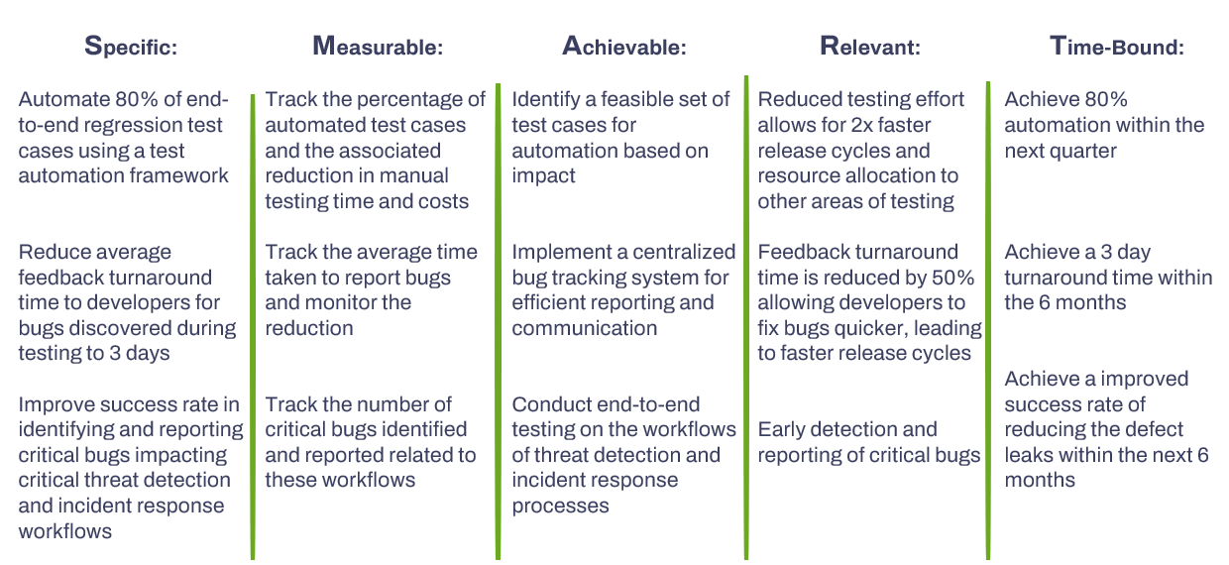
BO.1
BO.2
BO.3
Simple

Slide 9
Market Research
Title

Slide 10
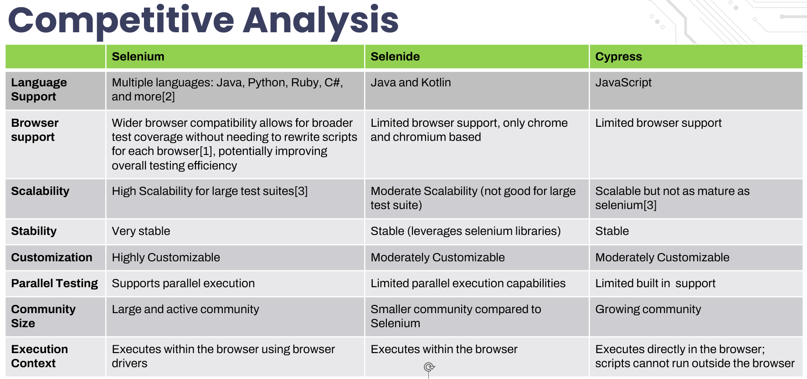
[1]Selenium Documentation, Supported Browsers v4.0(2022), https://selenium.dev/documentation/webdriver/browsers/
[2]Selenium Documentation, Installing Libraries v4.0(2023), https://selenium.dev/documentation/webdriver/getting_started/install_library/
[3] Himanshu Sheth, Selenium Tutorial and its Advantages, April, 2024, https:/.lambdatest.com/blog/why-selenium
[4]Selenium Documentation ,Bi Directional Functionality v4.0(2023),https://selenium.dev/documentation/webdriver/bidirectional/
Simple

Slide 11

‘Magic Quadrant’ Analysis
Cross-X Support
Mature and widely accepted and used across industries with cross and multi language and browser support [2]. Framework allows more control over browser interactions and integrations
Selenium
Simplified API offers less fine-grained control over browser interactions compared to Selenium, leverages selenium libraries and has browsers support other than chromium instances
Selenide
Niche
Scalability
Niche Player in the market and is inflexible for customization options for test data management [1], reporting, and framework integration.
Cypress
Inflexible
[1]Jash Unadkat, Comparison of Cypress, 2023,https://browserstack.com/guide/cypress-vs-selenium
[2] Himanshu Sheth, Selenium Tutorial and its Advantages, April, 2024, https:/.lambdatest.com/blog/why-selenium
Simple

Slide 12
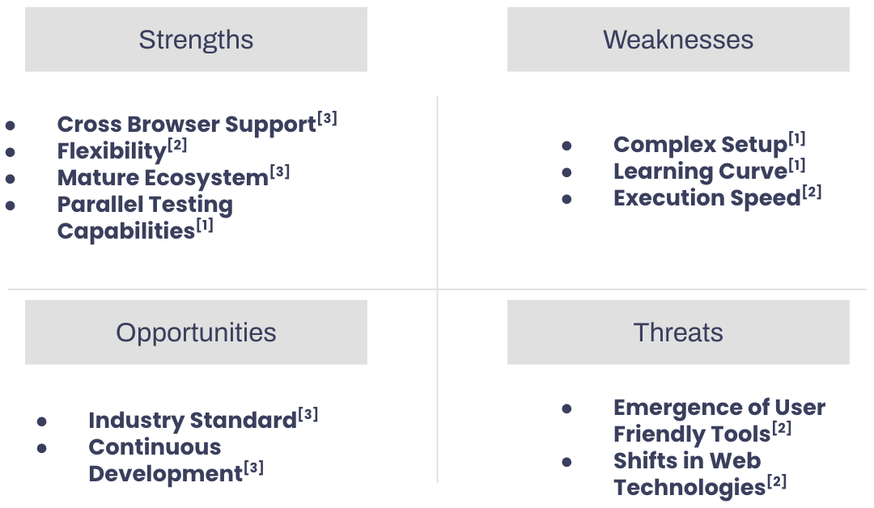
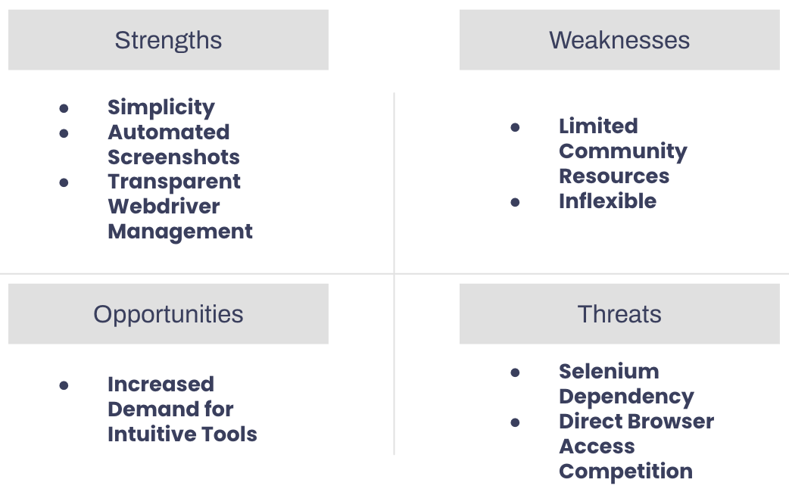
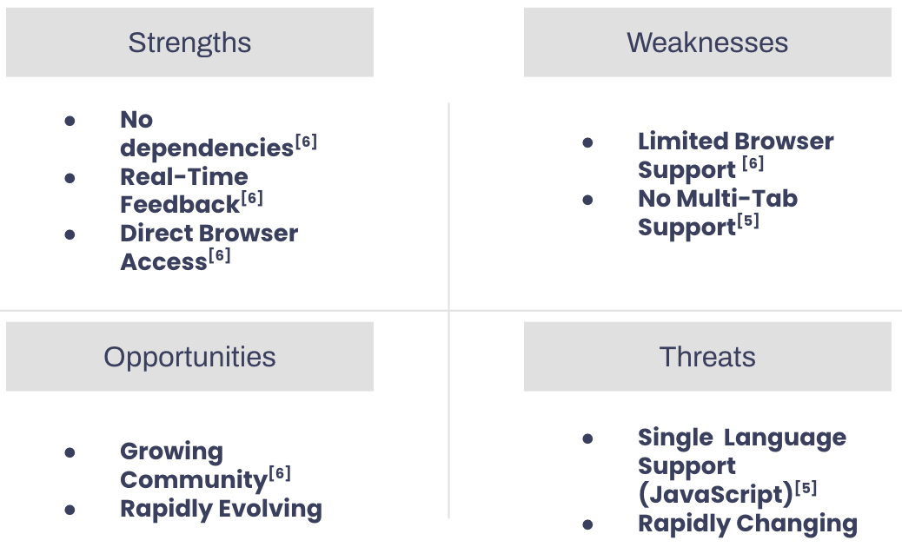
SWOT Analysis
Selenium
Selenide^{[4]}
Cypress
[1] (2024). Selenide vs. Selenium. Retrieved April 22, 2024, from https://selenide.org/documentation/selenide-vs-selenium.html
[2] Sheth, H. (2020). Cypress vs. Selenium Comparison. LambdaTest. Retrieved April 22, 2024, from https://www.lambdatest.com/blog/cypress-vs-selenium-comparison/
[3](2024). Selenium Tutorial. Retrieved April 22, 2024, from https://www.lambdatest.com/selenium
[4] (2024). Selenide vs. Selenium. Retrieved April 22, 2024, from https://selenide.org/documentation/selenide-vs-selenium.html
[5] Trade-offs. Cypress Documentation. Retrieved April 22, 2024, from https://docs.cypress.io/guides/references/trade-offs
[6] Sheth, H. (2020). Cypress vs. Selenium Comparison. LambdaTest. Retrieved April 22, 2024, from https://www.lambdatest.com/blog/cypress-vs-selenium-comparison/
Simple

Slide 13
OSS Research
Title

Slide 14
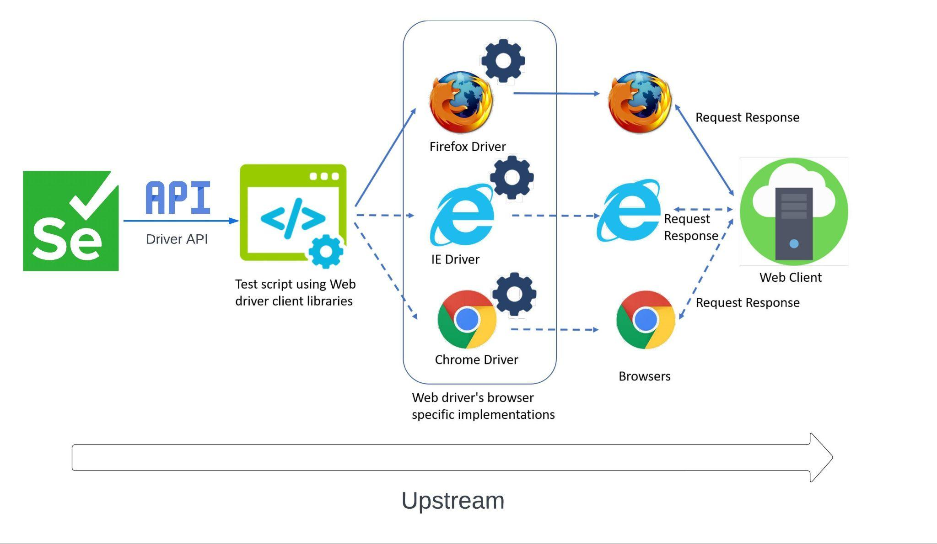
Upstream[1]
[1] BrowserStack. "Difference Between Selenium RemoteWebDriver and WebDriver." Accessed April 19, 2024. https://www.browserstack.com/guide/difference-between-selenium-remotewebdriver-and-webdriver.
Simple

Slide 15
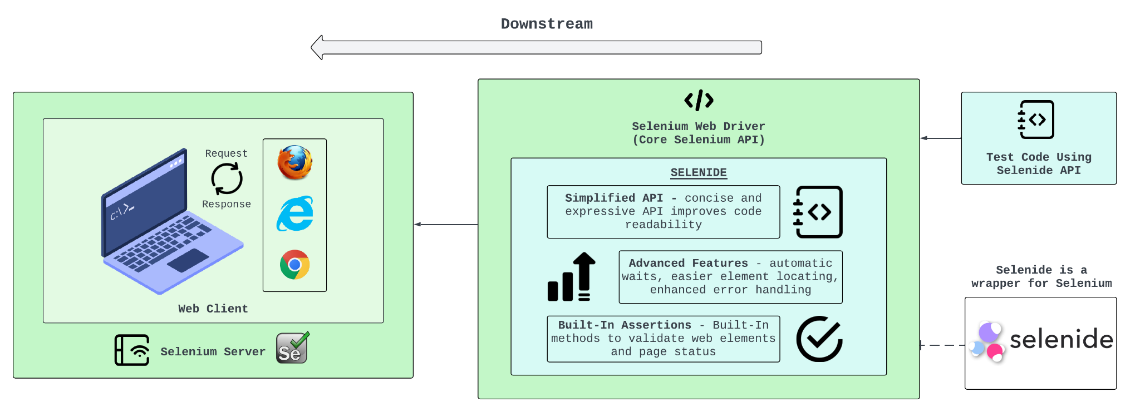
Downstream[1, 2]
[1] 2024. Selenide: concise UI tests in Java. Retrieved April 22, 2024 from https://selenide.org/
[2] Selenide vs. Selenium: What Are The Main Differences?. Retrieved April 22, 2024 from https://www.cybersuccess.biz/selenide-vs-selenium/
Simple

Slide 16
OSS Principles
Selenium is not tied to a specific programming language or platform. It offers bindings for various languages[3], allowing users to choose the one that best suits their needs. Additionally, the open-source nature makes it highly customizable for specific testing scenarios
Flexible
Selenium's source code is freely available under the Apache License 2.0 [1]
The Selenium project thrives on a vibrant community of developers [2]. They contribute code, documentation, and bug fixes, fostering a collaborative environment that results in a robust and feature-rich framework.
Principals:
Project Committers: Community members
Contributors: Jason Huggins (Selenium creator), Simon Stewart (WebDriver), Jim Evans (NET bindings), etc. [4]
Triagers: Andrei Solntsev, Isaul Vargas, Rajendra kadam, Chris NeJame, Todd Tarsi, etc. [5]
Maintainers: Simon Stewart (WebDriver creator), Jim Evans, Diego Molina (Selenium infrastructure), etc. [6]
Sponsors: Bright Data, BrowserStack, SauceLabs, Digital.ai, Applitools, Perfecto, LambdaTest, Subject7, Avo Automation, etc. [7]
Distributors: Selenium website, GitHub repository, Package managers, Cloud-based testing services, etc.[6]
End Users: Test engineers and QA professionals, DevOps teams, Automation engineers, Developers, etc. [8]
Open Source
Selenium
Collaboration
Cross-Browser and Multi Platform support
Cross-X Support
[1]Selenium Documentation, License v4.0,(2023),
https://selenium.dev/documentation/about/copyright/#license
[2]Selenium Repository,Framework and Ecosystem,https://github.com/SeleniumHQ/selenium
[3]Selenium Documentation, Supported Browsers v4.0(2022), https://selenium.dev/documentation/webdriver/browsers/
[4] The history of selenium testing: Sauce Labs: Sauce Labs. The History Of Selenium Testing | Sauce Labs | Sauce Labs. (n.d.).
https://saucelabs.com/resources/blog/a-brief-history-of-the-selenium-testing-framework
[5] Selenium project structure. Selenium. (n.d.). https://www.selenium.dev/project/structure/#selenium_triagers
[6] SeleniumHQ. (n.d.). SeleniumHQ/selenium-assistant: An assistant to help selenium maintainers keep the project in good shape. GitHub. https://github.com/SeleniumHQ/selenium-assistant
[7] Sponsors. Selenium. (n.d.-b). https://www.selenium.dev/sponsors/
[8] A deeper look at selenium. Selenium. (2022, September 4). https://www.selenium.dev/documentation/overview/details/
Simple

Slide 17
Personas and User Stories
Title

Slide 18
Story Points
 | GRADING | POINTS | RATIONALE
Planning Poker (Fibonacci)[1, 2] | Very Simple | 1 | The deliverable is extremely straightforward The team has all necessary resources at hand and can be easily comprehended It is expected to be completed quickly without any dependencies
 | Simple | 2 | The deliverable is clear with minimal intricacies, perhaps requiring one short discussion for alignment. It requires a single team member without needing input or assistance and can be completed independently
 | Moderately Simple | 3 | The deliverable is still simple and well understood but might require breaking it down into a couple of subdivisions. The team understands the primary goal but might need to clarify certain aspects or prerequisites. Deliverable would involve dependencies.
 | Moderate | 5 | A deliverable of moderate complexity, which might require a series of discussions to fully understand. The team can decompose it into 2-3 divisions that may require sequential flow and requires dependencies to drive it to completion
 | Fairly Complex | 8 | A highly complex deliverable that involves various aspects of the project and requires significant effort or problem-solving It will need to be divided into more than 3 smaller divisions and will require effort to define and clarity. The deliverable may have unknowns which might induce risk and has multiple dependencies
[1] MSIS2606,Class Notes, UseCase-UserStory - Relative Sizing (Planning Poker), April 2024
[2]Mastering Planning Poker: A Comprehensive Guide to Agile Estimation Technique,2023, https://community.atlassian.com/t5/App-Central/Mastering-Planning-Poker-A-Comprehensive-Guide-to-Agile/ba-p/2367611
Simple

Slide 19
DevOps Engineer - Jamie Teller
DESCRIPTION
Jamie Teller is an adept DevOps at CyberSiem Inc. in California, graduated with a Master's degree in Software Engineering from UC Berkeley. With a profound background in software development and a specialization in automating regression, functional, and UI tests, Jamie significantly elevates testing efficiency and precision. Jamie's proficiency with Selenium is matched by expertise in Jenkins for CI/CD (Continuous Integration/Continuous Delivery), enabling robust build pipelines, facilitating continuous integration and seamless deployment processes. Apart from his outstanding expertise, Jamie's exceptional communication skills streamlining software delivery and integrating cross-functional teams during life cycles of development.
RESPONSIBILITIES
Testing Automation: Implement tools extensively to automate 80% of the regression, functional, and UI testing processes to enhance testing efficiency and accuracy.
Maintenance of CI/CD Pipeline: Keep track of the testing performance and refine testing process continuously.
Efficiency & Optimization: Designed structures to reduced manual testing effort.
Cross-functional collaboration: Interact with both technical and non-technical teams collaboratively to enhance workflow.
PAIN POINTS / KEY NEEDS
Manual testing process drain resources which can be replaced with automation
Long testing time delaying feedback and test refinement, low responsiveness.
Persona Image: Slidesgo. "People Pattern." Accessed April 19, 2024. https://slidesgo.com/theme/people-pattern.
Simple

Slide 20
User Story ID | User Story Type | Priority | Story Point | Theme | User Story | Acceptance Criteria
J.1. | Epic User Story | 4 | 10 | Automation Integration | As a DevOps, I want to integrate the Automation Tools into our testing process, so that the average time taken in testing phases are reduced by 75% for faster execution of repetitive tasks. (from 4 days to 1 day) | IT Testers can review scrupulous regression testing performance right after a new SIEM build is pushed, so that test execution & feedback may be completed in under 24 hours.
J.1.1 | User Story | 1 | 5 | Optimization | As a DevOps, I want to integrate Selenium Webdrivers and Grid with our existing Jenkins CI/CD pipeline, so that the automated regression tests can reduce 80% manual intervention. | The process of automation replacements trigger regression tests automatically and instantly when Product Development pushes a new SIEM build if new build does not affect UI.
J.1.2 | User Story | 2 | 3 | Efficiency | As a DevOps, I want to ensure that the regression tests are optimized to reduce run time by 75%, so that test results can be reviewed under the 24 hour time constraint requirement. | If product update does not affect UI and require new test cases, IT Testers & SOC analysts are able to review the results within 24 hours after a new SIEM build is pushed. Otherwise, whole process takes 3 days. JUnit report is automatically pushed.
J.1.3 | User Story | 3 | 2 | Collaboration (Pair programing) | As a DevOps, I want to engage and work in pair programming tasks with DevTest team, so that we can collaboratively develop and refine automated tests. | Collaborative environment setup with scheduling system, documentation, and evaluation to ensure the quality of the pair programing without conflict and drawback of the workflow.
Average

Slide 21
IT DevTester - Brian Tran
DESCRIPTION
Brian Tran is a 27-year-old IT DevTester at CyberSIEM Ltd., holding a Bachelor's degree in Computer Science from SCU. With 5+ years of experience in IT infrastructure maintenance and cybersecurity, Brian specializes in managing the provisioning and infrastructure required to support CyberSIEM's customer 0 program. Brian collaborates with product development and SOC* (Security Operations Center) teams to relay customer 0 feedback and accommodate SOC testing needs. His proactive approach and dedication to maintaining high security and operational standards make him an invaluable asset to both the SOC and product engineering teams at CyberSIEM.
RESPONSIBILITIES
Infrastructure & Access: Ensures the IT infrastructure and access provisions are always up-to-date and functional for the seamless operation of the SIEM product.
Technical Support: Provides ongoing support to the SOC team, helping to troubleshoot and resolve any infrastructure-related issues.
Collaboration with Product Development: Works closely with product engineers to align IT infrastructure with new features and product updates.
PAIN POINTS / KEY NEEDS
Intermediary Challenges: Misunderstandings and delays between Product and SOC teams.
Test Support: Time-consuming, error-prone setup for new feature testing.
Persona Image: Slidesgo. "People Pattern." Accessed April 19, 2024. https://slidesgo.com/theme/people-pattern.
Simple

Slide 22
User Story ID | User Story Type | Priority | Story Point | Theme | User Story | Acceptance Criteria
B.1. | Epic User Story | 5 | 13 | Testing Excellence | As IT Dev/Test, I want to establish a Selenium testing environment and develop a suite of 300 automated unit tests so that SOC (Customer 0) receives updated builds in <72 hours. | 80% of 300 critical test cases are automated. 60 additional test cases are added to the automated testing suite. Critical tests have >97% precision. Test execution (manual and automated) <24 hours.
B.1.1 | User Story | 1 | 5 | Environment Setup | As IT Dev/Test, I want to provide a Selenium integrated environment, with relevant SIEM product access, so that Product Engineers and SOC analysts can write, execute, and validate test scripts. | IT Dev/Test and SOC analyst have access to the sandbox Selenium integrated java environment and can write test scripts that interact with a build of the SIEM product across across all browsers: Chrome, Edge, IE, Safari, & FireFox.
B.1.2 | User Story | 3 | 3 | Test Suite | As IT Dev/Test, I want Selenium testing of SIEM critical functionalities to include 60 more unit tests, with 50% fewer false positives, so that Customer 0 receives a more thoroughly vetted build. | Selenium test suite has >97% precision for 240 critical test points, and includes 60 additional non-critical test points.
B.1.3 | User Story | 4 | 3 | Efficiency | As IT Dev/Test, I want to increase the efficiency and speed of Selenium testing so that Customer 0 receives the build in <72 hours. | Selenium Grid executes test suite, in parallel, across all web browsers reducing the time required for the full test suite to <24 hours.
B.1.4 | User Story | 2 | 3 | Pipeline Integration | As IT Dev/Test, I want to integrate Selenium into the Jenkins CI/CD so that tests may be automatically conducted on a schedule or event driven basis. | Selenium testing can be triggered on a scheduled basis or after IT DevTest adds new unit tests. New tests appear in auto-generated JUnit report.
Average

Slide 23
Product Engineer - Krista Adams
DESCRIPTION
Krista Adams is a 35-year-old Product Engineer at CyberSIEM Ltd., holding a Master’s degree in Software Engineering. With 7 years of experience in software development, Krista specializes in cybersecurity products, focusing on enhancing the strategic threat detection and response capabilities of CyberSIEM’s SIEM solutions. Krista’s role involves collaboration with both the SOC* (Security Operations Center) and IT DevTest teams to ensure new developments meet rigorous quality standards. Known for her voracious appetite for feedback and team-player attitude, Krista plays a key role in driving product enhancements and ensuring that CyberSIEM remains at the forefront of the cybersecurity industry.
RESPONSIBILITIES
Feature Development: Designs and develops new features for the SIEM product, focusing on enhancements to threat detection and response
Quality Assurance: Works closely with IT and SOC teams to ensure all new developments are thoroughly tested and free from bugs before market release
Stakeholder Interaction: Collaborates with the SOC team, gathering internal customer (product development teams) level requirements and feedback to continuously refine product features and usability.
PAIN POINTS / KEY NEEDS
Customer 0 Feedback Loop: Slow and insufficient feedback from the Customer 0 program, due to manual testing by SOC, delays critical product iterations and impacts timely market responsiveness.
Persona Image: Slidesgo. "People Pattern." Accessed April 19, 2024. https://slidesgo.com/theme/people-pattern.
Simple

Slide 24
User Story ID | User Story Type | Priority | Story Point | Theme | User Story | Acceptance Criteria
K.1. | Epic User Story | 4 | 8 | Testing Excellence | As a Product Engineer, I want to receive feedback from SOC (Customer 0) the same week that an updated build is released for testing, so that I can begin implementing required changes. | If a change is made to the product that requires new unit test(s), then the creation of new test scripts and the execution of the full 360 unit test suite should take 72 hours or less. If no additional tests are added, then execution of the full test suit, including the 60 unautomatible tests, should take 24 hours or less.
K.1.1 | User Story | 1 | 3 | Test Suite | As a Product Engineer I want to ensure that IT regression testing is expanded so that fewer tests must be manually conducted by SOC. | IT automated regression testing covers 60 additional unit tests, and with 50% less false positives than the pre-automation (>97% precision).
K.1.2 | User Story | 3 | 3 | Efficiency | As a Product Engineer I want to ensure that new features tests are uploaded to the Selenium test suite in less than 48 hours so that new unit tests may be conducted. | For product updates requiring sample data for testing, IT Dev/Test & DevOps are alerted as soon as design is solidified. Sample data from Product BATs are sent to IT as soon as they are created.
K.1.3 | User Story | 2 | 2 | Pipeline Integration | As a Product Engineer I want to ensure consistent and concise regression testing analysis so that I can quickly identify issues and implement changes. | Automated JUnit test reports depict historical performance trends in columnar format. Screenshots of points of failure are included for subpar performing units.
Average

Slide 25
SOC* Analyst -Jennifer Clark
DESCRIPTION
Jennifer is a 38-year-old cybersecurity enthusiast and holds a master’s degree from UC Davis specializing in cybersecurity and has been working in the domain for over 4 years. She is married and has a son; Jennifer loves to paint and enjoys gazing at abstract painting. She has experience in working as a principal threat analyst and SOC analyst* (Security Operations Center) and was hired by CyberSIEM for the SOC Analyst role. Jennifer’s job as internal SOC analyst role involves the execution of end-to-end RBAC validation and checking if any of the threat detection and incident response workflows have broken due to a regression. She is always looking for innovative solutions to enhance the competitive posture of her organization. She directly reports to Alex Hart, Security Manager of the internal SOC team.
RESPONSIBILITIES
Testing: Evaluate the CyberSIEM product against a set of end-to-end RBAC enabled regression use cases
Effectively manage and analyze security events and incidents in real-time using the SIEM product
Research the emerging threat landscape and prepare proof of concept on including newer simulations
Owner or original developer of the 300 manual tests that are to be automated
PAIN POINTS / KEY NEEDS
Struggles with manually validating huge sets of the end-to-end RBAC regression use cases
Sarah experiences challenges with alert fatigue, overwhelming data volumes, and manual processes that hinder efficient incident response.
Persona Image: Slidesgo. "People Pattern." Accessed April 19, 2024. https://slidesgo.com/theme/people-pattern.
*Security Operations Center
Simple

Slide 26
User Story ID | User Story Type | Priority | Story Point | Theme | User Story | Acceptance Criteria
J.1 | Epic User Story | 4 | 8 | Core | As a SOC Analyst, I want to analyze CyberSIEM’s competitive posture and the product functionality such as threat detection, incident response, and security information management so that, I can eliminate potential defects, risks and threats. | Execute the end to end RBAC* regression test plan to assess core CyberSIEM functionalities for threat detection, incident response, and security information management. Document and prioritize l defects impacting the posture, focusing on high-risk issues
J.1.1 | User Story | 1 | 3 | Testing | As a SOC Analyst, I want to ensure the strategic Threat Detection & Incident Response functionality such as log analysis, alerting, data collection, vulnerability assessments, rollbacks, strict access controls is tested so that I can identify potential defects or limitations that could impact our ability to detect and respond to security incident | Continuous improvements to test plan to assess threat detection, incident response, and security information management functional capabilities (log analysis, alerting, data collection, vulnerability assessments, rollbacks, strict access controls, etc.).
J.1.2 | User Story | 3 | 2 | Triage and Reporting | As a SOC Analyst, I want to analyse the logs and find any failures and triage them accordingly so that I can summarize the findings to communicate insights | Document depicting the snippets triaging and analysis of the failures of the both packet and log analysis
J.1.3 | User Story | 2 | 3 | Testing | As an SOC Analyst, I want to navigate through various severity levels of aggregated incidents (Critical - Low) so that I can analyze the logs and packets that contribute to the triggered incident. | Test workflows and trigger conditions of Incident Severity Navigation, Incident Details View, Incident Details View, Alert correlation are being moderated to 97% true positives
*Role Based Access Control
Average

Slide 27
Security Manager -Alex Hart
DESCRIPTION
Alex is a 43-year-old man who is passionate about cybersecurity, thrives in a fast-paced environment, problem-solver, strong sense of responsibility. Further, he has excellent leadership and communication skills, ability to motivate and mentor a team, decisive and analytical thinking, ability to work under pressure, strong work ethic. He is equipped with strong understanding of security concepts, experience with security tools and technologies (SIEM, IDS, EDR), incident response procedures.Alex’s primary responsibility as a Security manager of the internal SOC* (Security Operations Center) team is to supervise the team and ensure smooth functioning in turn continuously improving the effectiveness of the SOC's operations. Further, Alex also oversees the financial aspects of a SOC, supports security audits, and reports the findings to CIO.
RESPONSIBILITIES
Processes: Creating processes; assessing incident reports; and developing and implementing necessary
crisis communication plans
Collaborate with the SOC team to ensure a holistic approach to end-to-end validation
Continuously improve the effectiveness of the SOC's operations
PAIN POINTS / KEY NEEDS
Finding and retaining qualified SOC analysts in a competitive job market
Deal with manual validation leakage consequences with the stakeholders
Balancing the need for robust controls with maintaining business continuity
Persona Image: Slidesgo. "People Pattern." Accessed April 19, 2024. https://slidesgo.com/theme/people-pattern.
Simple

Slide 28
User Story ID | User Story Type | Priority | Story Point | Theme | User Story | Acceptance Criteria
A.1.0 | Epic User Story | 4 | 8 | Operations | As a Security Manager, I want to focus on creating processes; assessing incident reports; and developing and implementing necessary crisis communication plans. Further, I want to oversee the financial aspects of a SOC, support security audits, so that I can report my findings to the CIO. | Ensure that the established & documented processes (incident response, crisis communication, security audits) correlates with the CyberSIEM’s protocol dashboard and is reviewed by the principal product engineer per the RACI matrix and document the verification. Review incident reports, develop & implement crisis communication. Further, ensure that the auditing for the external integration for licensing is done and documented.
A.1.1 | User Story | 1 | 3 | Performance | As a Security Manager, I want to be able to easily track key performance indicators (KPIs) for the SOC team, so that I can identify areas for improvement and demonstrate the value of the SOC to stakeholders | Define and implement a set of relevant KPIs viz; analyst review rate, alert classification accuracy with clear dashboards for visualization.
A.1.2 | User Story | 3 | 3 | Operations | As a Security Manager, I want to create crisis communication plans to address external and internal communication during security incidents, so that stakeholders are informed in a timely and coordinated manner, minimizing potential damage and reputational risks. | Define different communication scenarios based on the severity and type of security incident
A.1.3 | User Story | 2 | 2 | Efficiency | As a Security Manager, I want to create a comprehensive training program for new SOC analysts, so they can quickly become proficient in essential security tools and procedures. | Develop a training program covering core security concepts, SIEM/IDS/EDR tools, and incident response procedures to prepare for software disasters.Ensure that test framework access is limited to only the Product/Dev/Test/Engineering teams.
Average

Slide 29
SDLC Model
Title

Slide 30
Why Incremental with SCRUM?
Our development model is made up of three distinct increments, each comprising two 4-week sprints. This structure allows us to progressively develop and deliver usable features of the end product, while being responsive to changing requirements and diverse stakeholder feedback.
Project Requirements:
Quality: High repercussions require each feature to be rigorously tested
Flexibility: Clear core requirements, but diverse stakeholders come with changing needs
Early Delivery: User feedback requirement, and high Selenium learning curve requires incremental feature familiarity
Blend Benefits:
Each increment delivers deployable, testable software features, promptly enabling learning and stakeholder feedback. [2]
Early issue identification and resolution to focus resources effectively. [2]
Scrum encourages cross-department collaboration and minimum viable product delivery
Flexible Scrum practices within each increment allow for adaptation to changes. [3]
[1] ScrumStudy. Scrum and Quality. Retrieved April 22, 2024 from https://www.scrumstudy.com/whyscrum/scrum-quality
[2] Built In. Iterative vs. Incremental. Retrieved April 22, 2024 from https://builtin.com/software-engineering-perspectives/iterative-vs-incremental
[3] LinkedIn. Best Practices for Combining Extreme Programming. Retrieved April 22, 2024 from https://www.linkedin.com/advice/0/what-best-practices-combining-extreme-programming-19htc
[4] ScrumStudy. Scrum and Change. Retrieved April 22, 2024 from https://www.scrumstudy.com/whyscrum/scrum-change
Simple

Slide 31
SDLC Ingredients
Project Requirements | Incremental | SCRUM | Other Principles
High Quality | Validation: At the end of each increment, a testable feature is added, allowing for validation of requirements. [2] | Continuous Improvement: Requirements are re-evaluated at the end of each sprint. [1] Regular in-person meetings with stakeholders ensure correct project direction. | Pair Programming: Ensures that interdepartmental tasks are high quality, efficient, and result in knowledge sharing. [3] Testing: Tests are developed to accompany user stories for these tasks. These tests further reduce ambiguities.
Change Accommodation | Flexible: Each increment is split into 2 Sprints. Increment-level requirements can change with Sprint-level requirement churn. [2] | Sprint Planning & Retrospective: Short feedback loop (4 week Sprint) between project team and customer ensures accommodation of changing stakeholder requirements. [4]
Early Delivery | Deployable: Each increment is expected result in an updated product, building upon the last increments' features. [2] This gives stakeholders time to learn how to use Selenium, as more features/tests are added. |  | Simplicity: The team will focus on delivering the minimum functional solution first, then work on increasingly complex functionalities [3]
[1] ScrumStudy. Scrum and Quality. Retrieved April 22, 2024 from https://www.scrumstudy.com/whyscrum/scrum-quality
[2] Built In. Iterative vs. Incremental. Retrieved April 22, 2024 from https://builtin.com/software-engineering-perspectives/iterative-vs-incremental
[3] LinkedIn. Best Practices for Combining Extreme Programming. Retrieved April 22, 2024 from https://www.linkedin.com/advice/0/what-best-practices-combining-extreme-programming-19htc
[4] ScrumStudy. Scrum and Change. Retrieved April 22, 2024 from https://www.scrumstudy.com/whyscrum/scrum-change
Simple

Slide 32
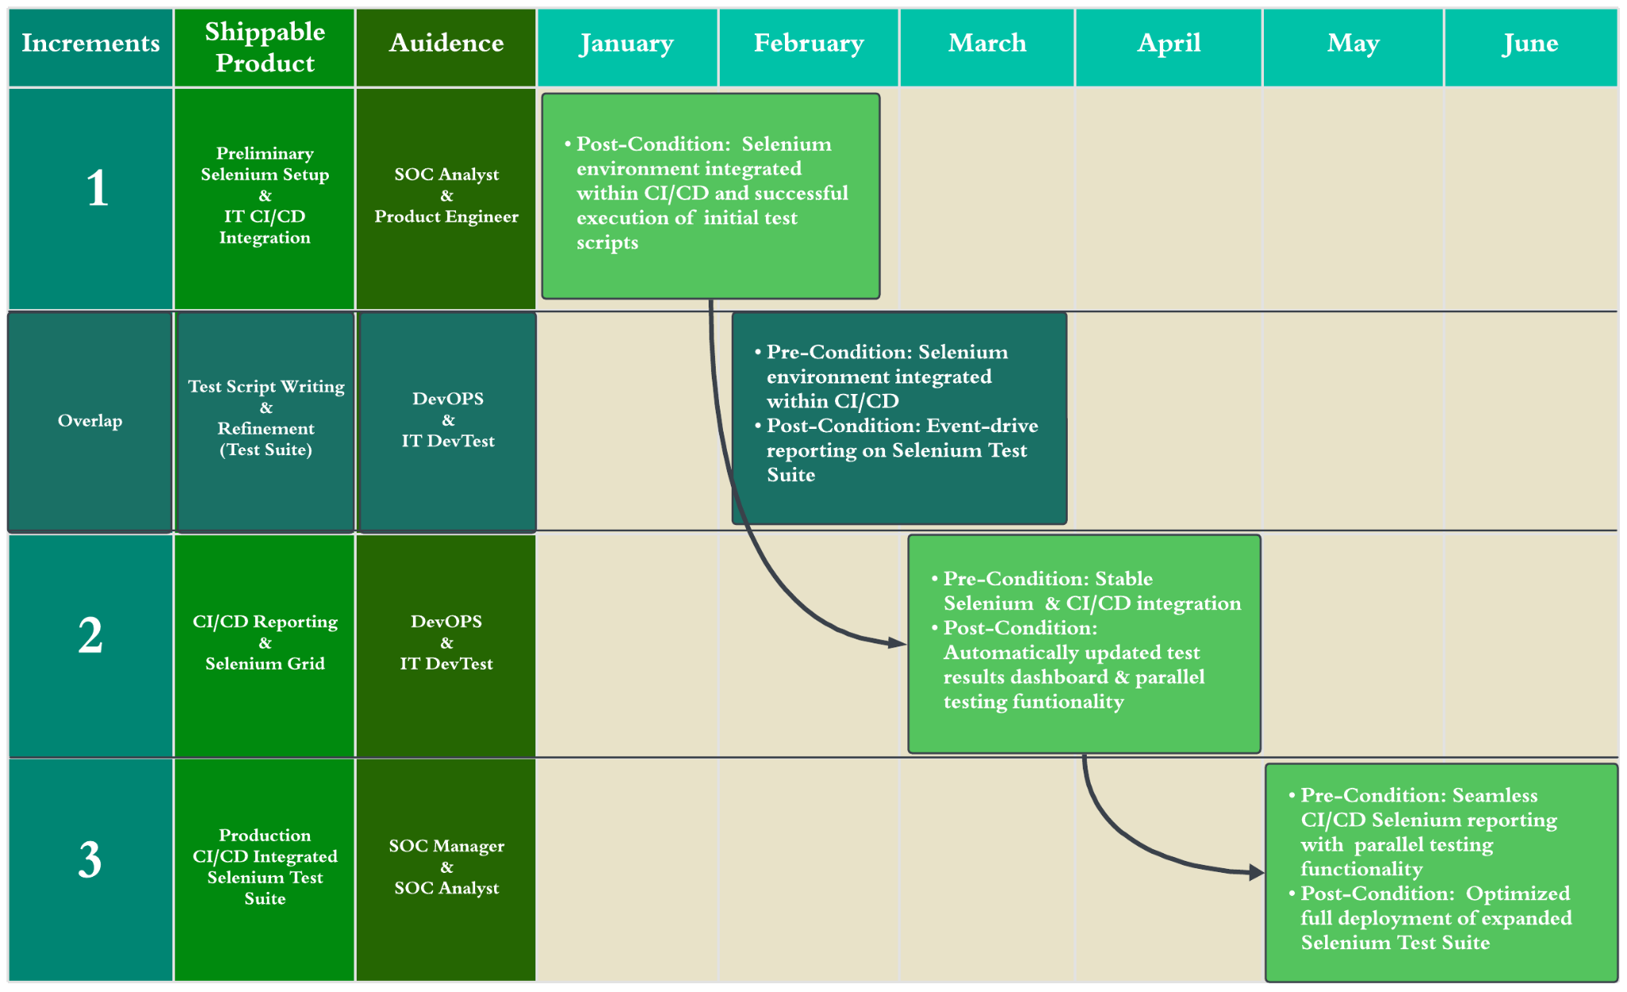
Simple

Slide 33
Product Roadmap
Title

Slide 34
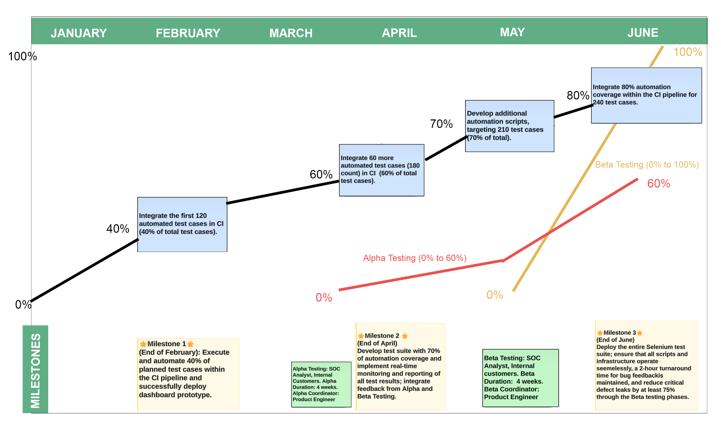
Product Roadmap
Simple

Slide 35
Sprint Planning
Title

Slide 36
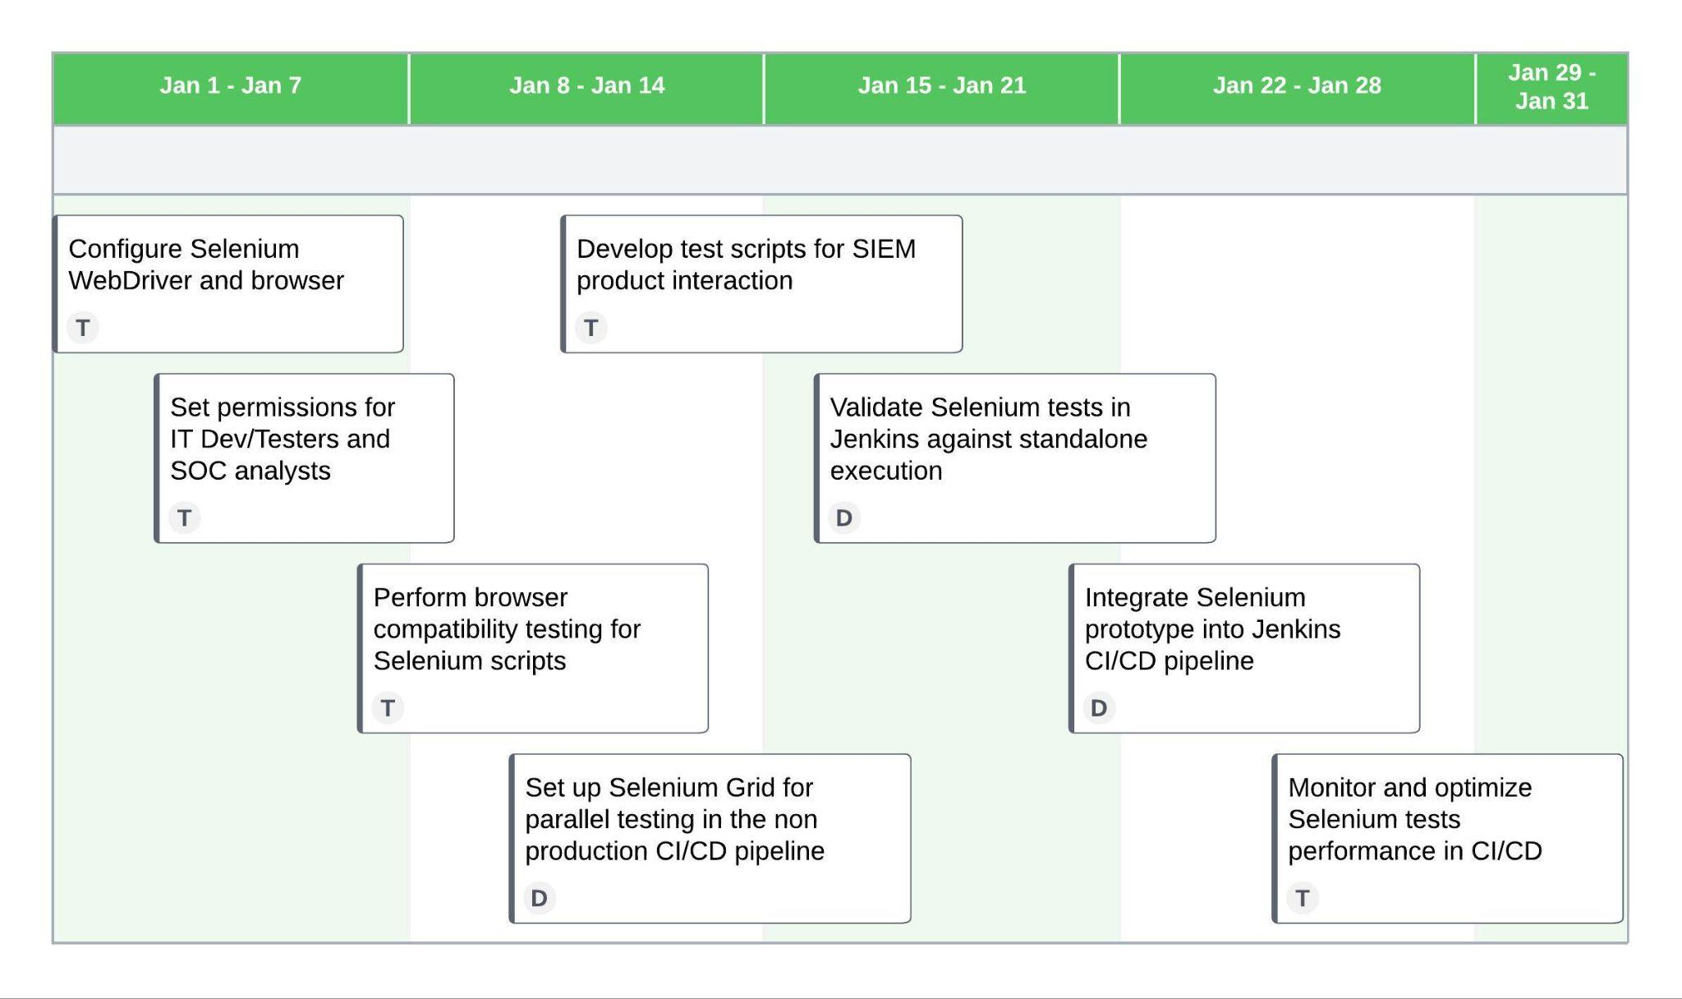
Sprint 1
Sprint 1 Goal: Setup environment for Selenium implementation; Initial integration of the Selenium script prototype into IT CI/CD to validate stability.
Story ID | User Story | Owner | Story Points
J.1.1 | Integrate Selenium Webdrivers and Grid | DevOps Engineer | 5
J.1.2 | Regression tests optimization | DevOps Engineer | 3
B.1.1 | Testing environment setup | DevTester | 5
B.1.2 | Testing performance monitoring | DevTester | 3
B.1.4 | Automation time reduction | DevTester | 3
Simple

Slide 37
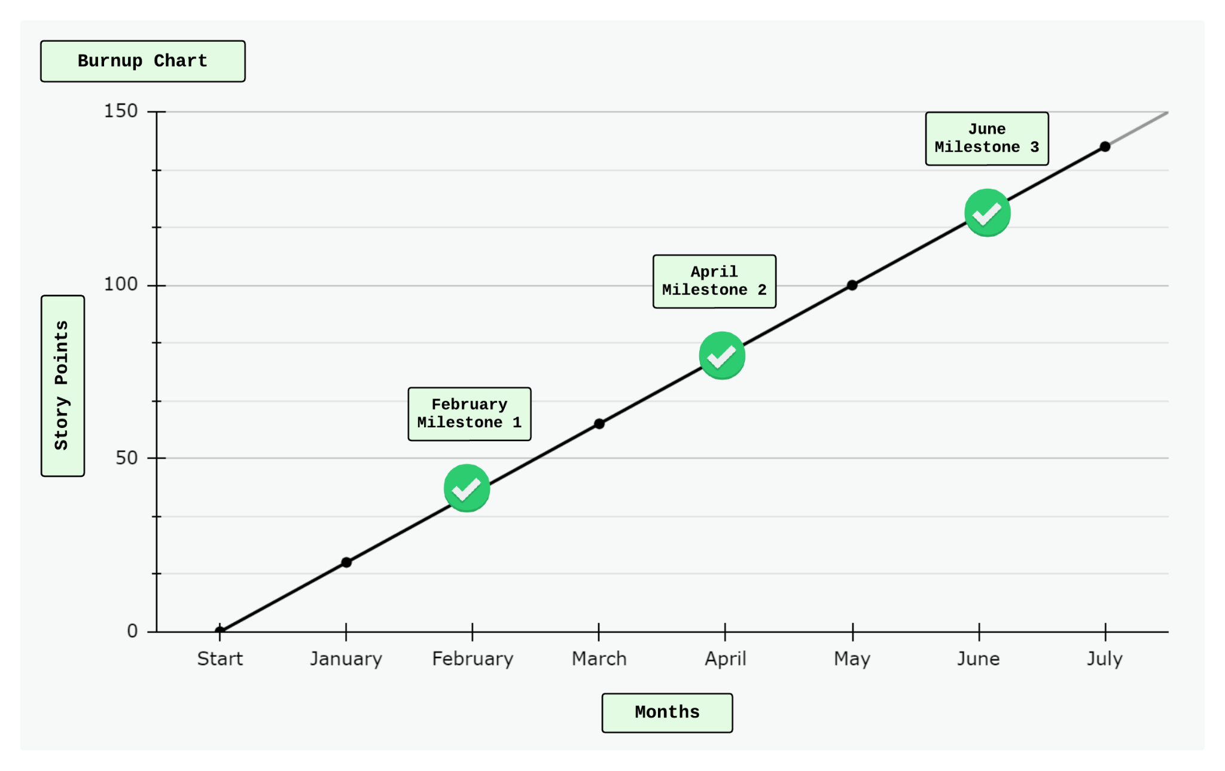
Burnup Chart
Milestone #1:
Execute and automate 40% of planned test cases within the CI pipeline and successfully deploy dashboard prototype.
User Stories:
B.1.1., B.1.2, B.1.4, J.1.1
Milestone #2:
Achieve 70% of automation coverage and achieve real-time monitoring and reporting of all test results.
Alpha Testing with 60% resolution rate for verified issues in alpha
User Stories:
J.1.2, J.1.3, B.1.3, K.1.1, K.1.2, K.1.3
Milestone #3:
Full deployment of the Selenium test suite, with functioning scripts and infrastructure.
User Stories:
J.1.1, A.1.1, A.1.2, A.1.3
Simple

Slide 38
ROI & ROV
Title

Slide 39
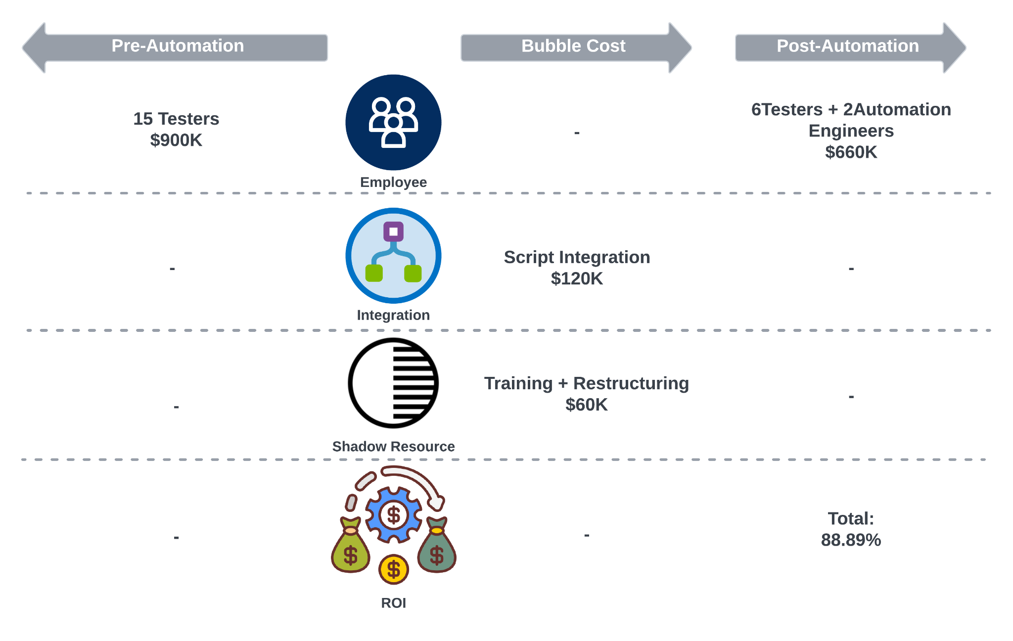
ROI
Simple

Slide 40
ROV
Time Efficiency | Reduce time expense per case by 64.17%, from 11.22 minutes to less than one minute.
Test Coverage and Frequency | Improve test coverage from 70% to 90%. Reduced false positive rate of test cases from 5% to 3%.
Resource Optimization and Cost Efficiency | Save team’s time on testing by 57.14%. Generate $16K of financial value per month from productivity improvement.
Consistency and Reproducibility | Shorten the test setup and validation process from 72 hours to 48 hours.
Rapid Feedback and Continuous Improvement | Reduce the reaction time from Internal SOC (Customer 0) to Product from 48 hours to 24 hours.
Simple
Notes:
Time Cost per Case Calculation:
Pre-automation:
Total test duration: 7 days
Number of test cases: 300
Work hours per day: Assuming 8 hours/day
Total work hours: 7 days×8 hours/day=56 hours
Time cost per test case:56 hours / 300 cases ≈ 0.187 hours/case
Post-automation:
Total test duration: 3 days
Number of test cases: 360
Work hours per day: Assuming 8 hours/day
Total work hours: 3 days × 8 hours/day = 24 hours
Time cost per test case:24 hours / 360 cases ≈ 0.067 hours/case
Resource Benefit Calculation:
Pre-automation monthly test hours: 2000×0.187=374 hours/month
Post-automation monthly test hours: 2000×0.067=134 hours/month
Assumed Hourly Rates:
Tester's hourly rate: $50
Automation engineer's hourly rate: $75
Cost Calculation:
Pre-automation cost: Cost = 374 hours/month × 15 testers ×$50/hour=$24,933.33/month
Post-automation cost: Cost =134 hours/month × (6 × $ 50 + 2 × $ 75 ) = $8,950/month
Monthly Shadow Resource Benefit: Shadow Resource Benefit =$24,933.33 − $8,950 = $15,983.33/month
Shadow Resource Benefit over 6 months: Shadow Resource Benefit (6 months)=$15,983.33×6=$95,900

Slide 41
Risk Analysis
&
Software Disasters
Title

Slide 42
Risk Analysis
Risk | Risk Description | Mitigation Strategy | Impact | Likelihood
Cross-Browser Compatibility Issues | UI flow between browsers may be different. If browser updates affect the UI, test scripts may not work. | Use a Browser Compatibility Matrix to determine where code can be reused, and what must be custom. Update all browsers to determine if UI changes affect test scripts. If they do, DevTest must be alerted so changes can be made. to ensure that the newest security measures are updated and eliminate bugs [1] | High | Medium
No Built-In Reporting Capabilities | 3rd party (JUnit) reporting comments must be updated when test scripts change. If JUnit comments are not updated, reports will not represent new test cases. | Formally Audit JUnit reports quarterly to ensure that reports are representative of the test suite. Review JUnit updates before implementing them to ensure no compatibility issues occur. | High | Medium
Performance Bottlenecks & Scalability Issues | Many test instances require product and data access, adding to system strain. Potential to overload local resources, resulting in system crash. | Parallel Testing sequence changes are immediately implemented if a new test has a dependency. Use Explicit Wait Commands to allow precise control over waiting conditions, minimizing long wait times & maximizing resources. Overclock local compute quarterly to determine the maximum concurrent test instances possible. Utilize cloud compute for Selenium Grid in the case that local compute cannot complete testing within 1 day reporting threshold [4] | High | Medium
Test Spottiness | Complex UI flows may result in test spottiness in the long run. Inadequate variety in sample data may mask edge cases. | Keep tests simple to improve test stability and reliability. Continuously add to sample data repo and randomize sample data selection to diversify scenarios. Consistent Test Configuration - On a quarterly basis, run test scripts in isolation from the production environment to ensure that the pipeline reporting is consistent [3] | High | Medium
Frequent Updates and Maintenance | Changes to SIEM products may result in significant test script deprecation. | Page Object Model (POM) makes it easier to adapt to frequent updates by isolating web page elements from test scripts, improving code maintainability and scalability [2] Product will Proactively Alert DevTest and DevOps of significant UI changes in the design phase of product development, allowing ample time to accommodate the testing changes. | Medium | High
[1] BrowserStack. 6 Best Practices in Selenium Automation. Retrieved April 22, 2024 from https://browserstack.wpengine.com/guide/best-practices-in-selenium-automation/
[2] LambdaTest. 16 Selenium Best Practices For Efficient Test Automation. Retrieved April 22, 2024 from https://www.lambdatest.com/blog/selenium-best-practices-for-web-testing/
[3] Folio3 Software. Risks and Challenges in UI Automation with Selenium. Retrieved April 22, 2024 from https://folio3.com/blog/risks-and-challenges-in-ui-automation-with-selenium/
[4] 2024. Cloud Selenium Grid for Test Automation. Retrieved April 28, 2024 from https://www.browserstack.com/cloud-selenium-grid
Average

Slide 43
Software Disasters
Threat | Description | Recovery Plan | Mitigation
Internal Security Threat During Deployment | Undisclosed vulnerabilities in an internal update lead to unauthorized access, compromising critical data and triggering a security disaster | Halt deployment and notify SOC team of the security breach Implement emergency patches or rollback procedures to restore system integrity Conduct a post-incident analysis to identify the root cause and improve internal testing processes | Implement strict access controls to limit outsider access to critical data Invest in continuous monitoring and threat detection mechanisms to detect unauthorized access and anomalies. Run monthly security checks and vulnerability assessments
Unreliable Test Results due to Flaky Tests | Flawed automation scripts result in false positives, causing critical errors post-deployment and leading to a declared software disaster | Pause production developments until the errors are identified and resolved Cross-team collaboration to debug and optimize the test scripts for reliability Communicate with SOC team stakeholders about the false-positive results | Isolate the test environment to minimize external factors on test consistency Use Test Frameworks such as TestNG or JUnit for generating comprehensive test reports and providing better error handling capabilities [1]
CI/CD Pipeline Scalability Issues | Inefficient scalability of automation infrastructure causes downtime, disrupting deployment and impacting business operations, culminating in a software disaster | Conduct a performance analysis of the automation infrastructure to identify scalability bottlenecks Implement monitoring and alerts to actively identify potential scalability issues Scale up or optimize based on workload demands and traffic patterns | Implement auto-scaling mechanisms to dynamically adjust automation server capacity based on workload Leverage Selenium cloud-based automation for scalability and elasticity in handling fluctuating workloads
[1] Top 5 Mistakes in Automated Testing. Retrieved April 25, 2024 from https://www.softwaretestingmagazine.com/knowledge/top-5-mistakes-in-automated-testing/
Simple

Slide 44
Risk Management
Title

Slide 45
Risk Management - Scenario
Internal Threat Instance Resulting in a Data Breach
When releasing a new update for their regression testing product, CyberSIEM encounters an internal threat instance that results in a data breach. The rushed timeline for deployment leads to improper testing and inadequate security measures within the testing environment, allowing unauthorized access to sensitive data.
Scenario Description
Mark Carlton, a newly hired Technical Writer at CyberSIEM, brings valuable experience from his previous role at a competitor company. Assigned to a joint project involving the SOC, testing, and development teams, Mark is responsible for writing project documentation that will later be reviewed by the Exec Board. This requires Mark to access specific project-related documents stored in a shared system. However, due to a configuration oversight, Mark's access permissions extend beyond document repositories, which grants him access to the automated regression testing environment.
Due to a lack of proper security measures, Mark is easily able to download key parts of the data. Mark then distributes this information amongst previous colleagues and other industry leads, resulting in a data breach that compromises CyberSIEM's proprietary algorithms and confidential data.
Impact
Data Exposure: This data breach exposes sensitive information, including proprietary algorithms and confidential data, to unauthorized individuals, risking its integrity and confidentiality.
Reputational Damage: CyberSIEM's reputation for data security and reliability is compromised, leading to a loss of trust from the Exec Board, stakeholders, and industry partners.
Financial Loss: The breach results in a huge financial loss due to legal consequences and cost of remediation efforts.
Operational Disruption: Addressing the breach disrupts normal operations, diverting resources from other critical tasks.
Simple

Slide 46
Risk Management - Response
Response Plan
Security Enhancements: CyberSIEM strengthens its security measures using access controls, encryption, and monitoring systems to prevent future unauthorized access and data breaches[1].
Employee Training: Employees undergo comprehensive security awareness training to educate them about data security best practices and the importance of safeguarding sensitive information. Additionally, it is emphasized that employees must prioritize data security measures and access control no matter how rushed the project deadline is.
Regular Audits and Risk Assessments: Regular security audits and vulnerability assessments are conducted on a monthly basis to identify and address potential security gaps[2].
Legal Repercussions: CyberSIEM pursues legal action against Mark Carlton for his unauthorized access and malicious use of sensitive company data.
Mitigation Strategies
Incident Investigation: CyberSIEM initiates a thorough investigation to determine the scope and impact of the data breach, identifying the security vulnerabilities within the framework and the critical data exploited by Mark.
Data Recovery: Efforts are made to recover and secure the compromised data, minimizing further exposure and damage [3].
Data Compliance: As a result of the data breach, CyberSIEM must strictly follow data security and compliance rules such as the California Consumer Privacy Act (CCPA) and the General Data Protection Regulation (GDPR), which ensures that personal data is handled responsibly, transparently, and in accordance with legal requirements.
Communication: Transparent communication is maintained with the affected parties, including the Exec board, the SOC Team (customer 0), and regulatory authorities following the incident. This ensures accountability, compliance, and effective collaboration when addressing the breach and implementing mitigation strategies.
[1] 2024. How can encryption be used to prevent a data breach?. Retrieved April 26, 2024 from https://www.linkedin.com/advice/1/how-can-encryption-used-prevent-data-breach-b8xgf
[2] Data breach prevention: 5 ways attack surface management helps mitigate the risks of costly data breaches. Retrieved April 26, 2024 from https://admin01.prod.blogs.cis.ibm.net/blog/5-ways-attack-surface-management-helps-mitigate-risks-data-breaches/
[3] 2024. Data breach prevention strategies for 2024. Retrieved April 26, 2024 from https://preyproject.com/blog/how-to-prevent-data-breaches-5-essential-tips
Simple

Slide 47
Architecture
& Design
Title

Slide 48
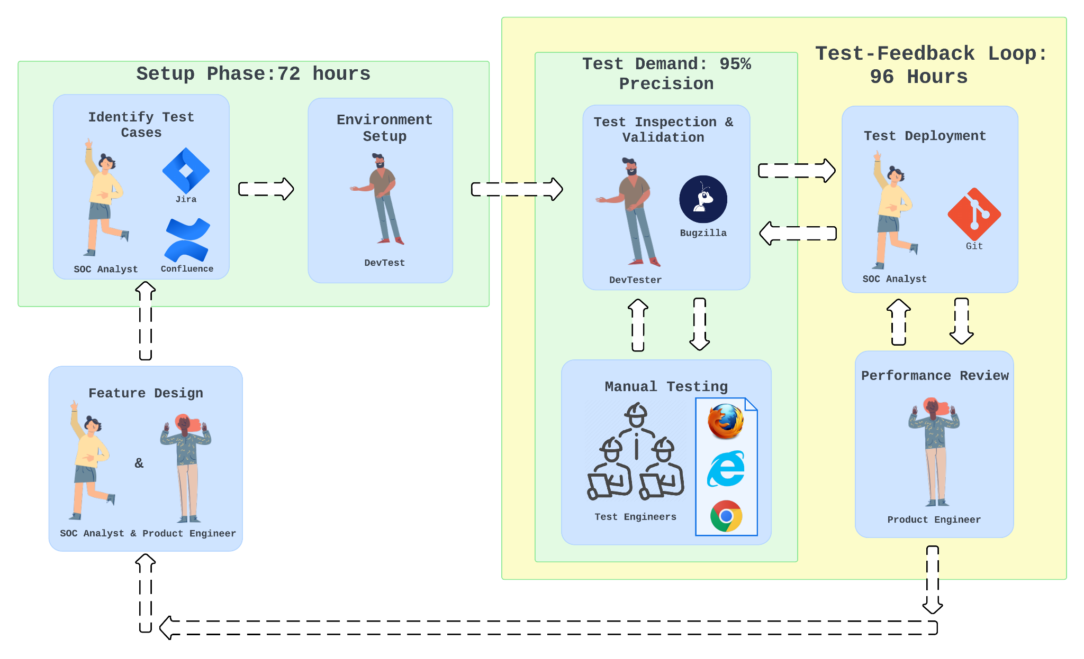
As-Is
[1]Logo: Google Chrome, Browser, https://www.google.com/chrome/
[2] Logo: Microsoft Edge, https://microsoft.com/en-us/edge
[3]Logo:Mozilla Firefox, Browser, https://mozilla.org/en-US/firefox/new/
[4]Logo:Jira,https://atlassian.design/foundations/logos
[5]Logo:Confluence,https://www.atlassian.com/legal/trademark#our-trademarks
[6]Logo:git,https://git-scm.com/downloads/logos
[7]Logo:bugzilla,https://www.svgrepo.com/svg/331330/bugzilla
[8]Automation rules and templates for Confluence Premium. Retrieved May 13th, 2024 from https://www.atlassian.com/software/confluence/automation
[9]Environments and deployments | GitLab. Retrieved May 10th, 2024 from https://docs.gitlab.com/ee/ci/environments/
[10] How To Write Effective Test Cases & Bug Reports With Jira and Bugzilla. Retrieved May 13th, 2024 from https://medium.com/@noel.B/how-to-write-effective-test-cases-bug-reports-with-jira-and-bugzilla-58e222d4b099
[4]
[7]
[6]
[5]
300 Manual Tests
[3]
[2]
[1]
Simple

Slide 49
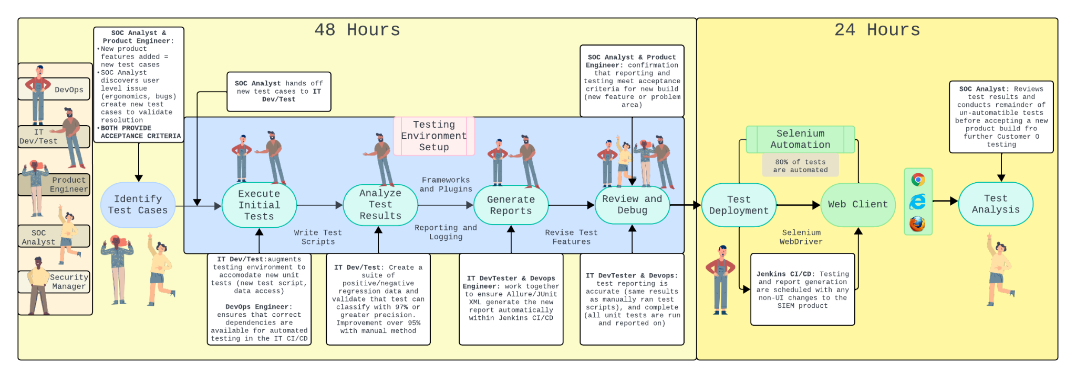
To-Be
[1]
[2]
[3]
[1]Logo: Google Chrome, Browser, https://www.google.com/chrome/
[2] Logo: Microsoft Edge, https://microsoft.com/en-us/edge
[3]Logo:Mozilla Firefox, Browser, https://mozilla.org/en-US/firefox/new/
Simple

Slide 50
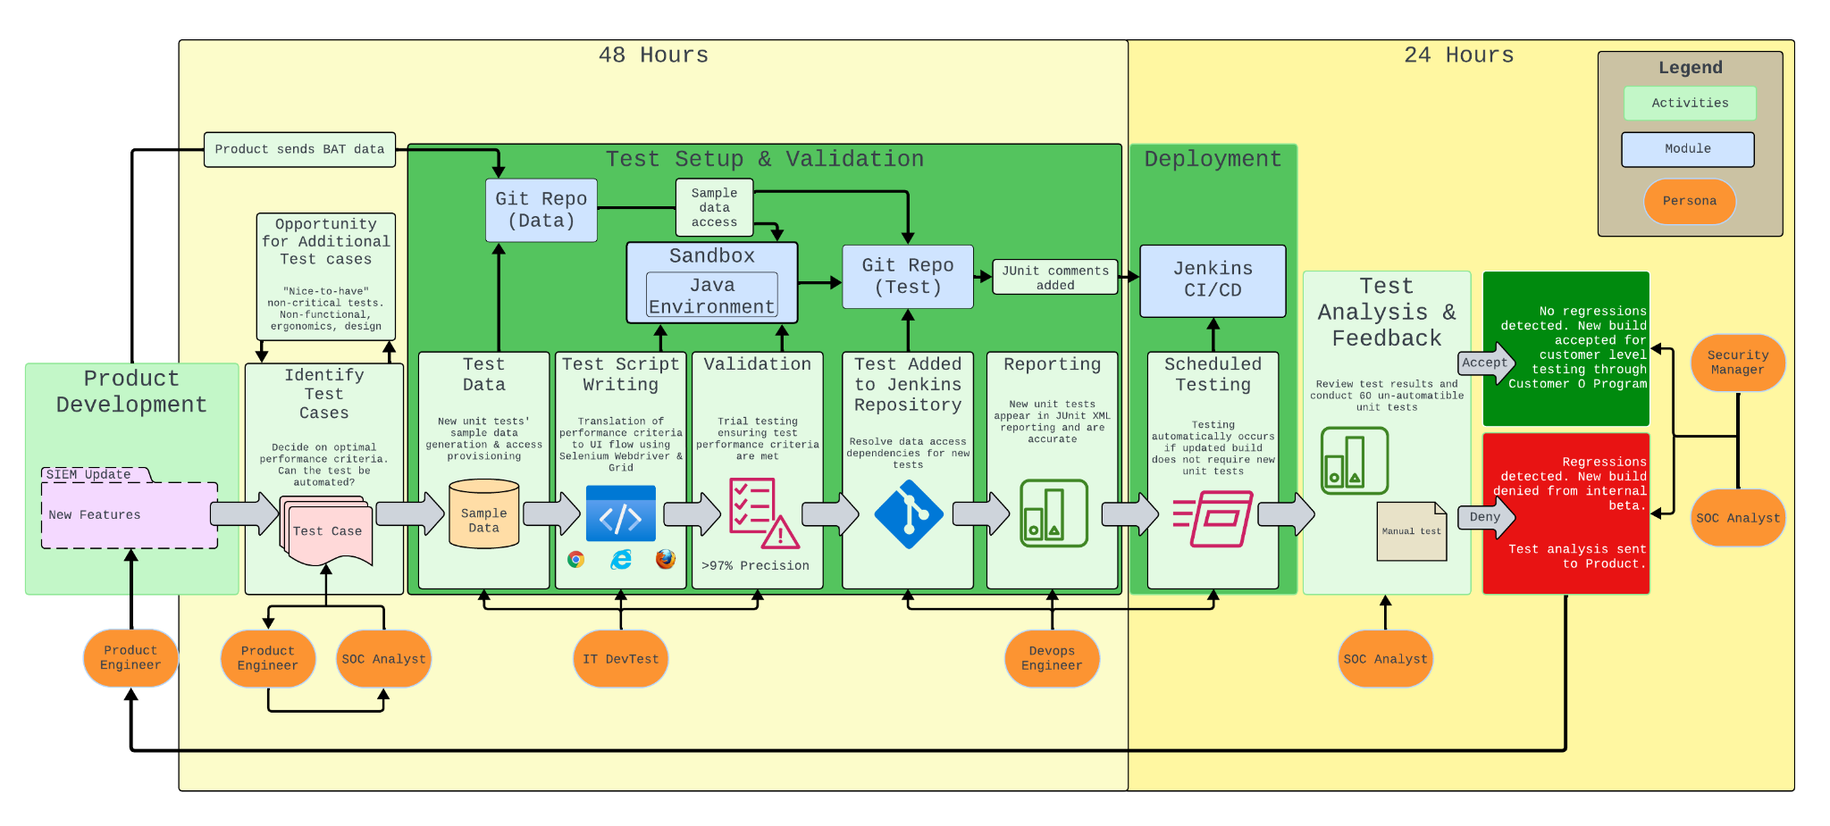
Architecture
[1] [2] [3]
[1]Logo: Google Chrome, Browser, https://www.google.com/chrome/
[2] Logo: Microsoft Edge, https://microsoft.com/en-us/edge
[3]Logo:Mozilla Firefox, Browser, https://mozilla.org/en-US/firefox/new/
Average

Slide 51
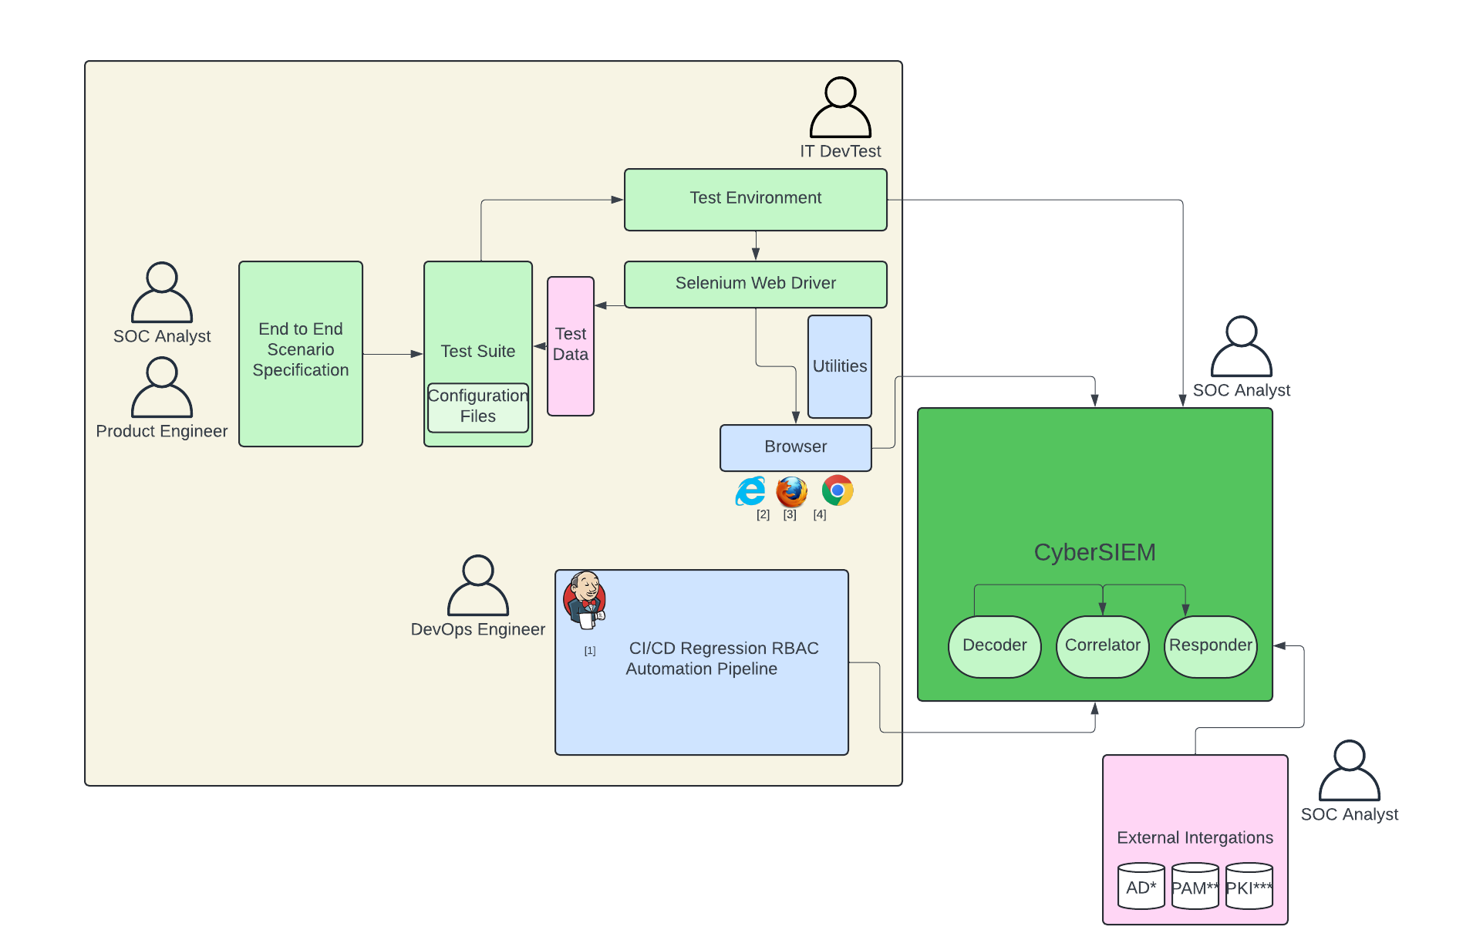
High Level Design
[1] Logo: Jenkins, Jenkins Pipeline https://jenkins.io/
[2] Logo: Microsoft Edge, https://microsoft.com/en-us/edge
[3]Logo:Mozilla Firefox, Browser, https://mozilla.org/en-US/firefox/new/
[4]Logo: Google Chrome, Browser, https://www.google.com/chrome/
*Active Directory
**Privileged Access Management
***Public Key Infrastructure
Simple

Slide 52
Testing
Title

Slide 53
Test Strategy & Methodology
Test Theme | Test Strategy Rationale | Test Strategy Requirements | Test Methodology
Precision | Ensure that automated test scripts throw out fewer false positives than manual testing and provide increased test coverage of the SIEM functionalities. | Need to determine what can and cannot be automated; reducing the risk of insufficient test coverage is crucial. Due to the Customer 0 program, internal use (IT team/ SOC) of the updated build depends on thorough regression testing and accurate reporting. Different browsers may have different UI flows, so ensure performance consistency. | Unit Testing: Historical product build with known issues is tested with the prospective automated test script. Result of test is compared with historical manual method report. Regression Testing: CI/CD triggered test scripts retain same level of precision as before CI/CD integration. Integration Testing: CI/CD triggered JUnit test reports summarize problem areas and trends. JUnit Reports are compared with historical manual reports. Beta (UAT) Testing: Proactive communication between Customer 0 (SOC Team), Product and DevTest when simulating each build so that issues with test precision, accuracy, and consistency are identified prior to release.
Efficiency | The previous manual method took 7 days to setup and execute testing on 300 unit tests. In comparison, the setup and automated test execution only takes 72 hours for both 300 automated unit tests and around 60 remaining manual unit tests | CI/CD testing triggers verify whether updated builds include new UI features. Make sure that Selenium Grid enables parallel testing across multiple browsers. Multiple copies of the updated build may be required for parallel testing, necessitating hardware capable of handling the load. DevTest requires continuous communication with Product to anticipate new UI features well in advance of updates. Regular updates are crucial to mitigate environment setup bottlenecks and achieve the 72-hour timeframe. | Unit Testing: If the updated build has no new UI features, CI/CD testing is automatically triggered and testing begins immediately. Otherwise, test execution is paused until Devtest manually triggers. System Testing: Optimize number of Selenium Grid instances possible with proposed hardware. If number of instances causes system crash. Alpha Testing: Continuous line of communication with Product allows DevTest to begin environment setup before the updated build is officially released.
Security | Need to ensure that access to sample data and test script repository are restricted to only IT, Devops, and Product teams; also prepare crisis management strategies and security training for all company employees | Need to ensure that all changes to the test suit are continuously reported with doxygen comments. Obtain consensus between Product, DevTest, and SOC groups before a change is made to the test suite. Ensure active logging, monitoring, and communication regarding potential issues and threats. Establish an incident response and recovery plan in case access is breached. | Unit Testing: Verify that only Product Engineer, SOC Analyst, IT DevTest, and DevOps Engineer can access test script repository; all changes must involve consensus between at least two parties. Alpha Testing: Conduct early-phase testing in an isolated testing environment. Log real-time feedback from the team in addition to automated reports. Recruit Regression Testing: Automate security scans to identify and report issues for each build so that the team is aware of potential threats. Security Testing: Create comprehensive incident response and recovery plan through rollbacks, automated test backups, intrusion detection systems (IDS).
Average

Slide 54
Test Plan
[1] Connect Jira Service Management to Slack and Microsoft teams. Retrieved May 23, 2024 from https://www.atlassian.com/software/jira/service-management/product-guide/tips-and-tricks/chat\
[2] How to integrate Jenkins with Selenium?. Retrieved May 23, 2024 from https://browserstack.wpengine.com/guide/jenkins-selenium/
[3] JUnit. Retrieved May 23, 2024 from https://plugins.jenkins.io/junit
Increment | Testing Type | Test Theme | User Stories | Test Objective | Architecture/Tools | Criteria
1 | Unit | Precision | As IT DevTester Brian Tran, I want to first develop a suite of 300 automated unit tests to ensure automated builds and then develop 60 more unit tests with 50% fewer false positives | Develop automated tests and compare results with manual testing method to confirm high level of precision with automation | Unit Testing: Java Test Framework, Selenium WebDriver 2] | Test the automated product build to ensure that it has 50% less false positives as compared to the original manual method
1, 2 | Integration | Efficiency | As DevTester Brian Tran, I want to create a Selenium integrated environment with Jenkins CI/CD for test scripts. | Achieving seamless integration between Selenium, Jenkins, and the Java environment | Integration Testing: sandbox environment, Selenium Grid, Selenium WebDriver, Web Browsers | Verify that Jenkins efficiently initiates and executes Selenium test scripts while ensuring proper logging of test results
 |  |  | As DevOps Jamie Teller, I want to integrate the Automation Tools into so that the test execution time is reduced by 75% | Enhance the testing process to ensure efficiency, stability, and minimized execution time | Integration Testing: Selenium WebDriver, Selenium Grid, JUnit | Use parallel testing in Selenium Grid to optimize the testing process and ensure system stability under peak load
2 | Alpha | Efficiency | As Product Engineer Krista Adams, I want to get critical feedback from the SOC Analyst and internal customers (product development teams) to quickly identify and implement improvements per feedback | Ensure test environment functionality by gathering and documenting feedback from Product, Devops, and DevTest teams | Alpha Testing: Slack app / Microsoft Teams, Jira platform [1] | Proactive communication between SOC, Product and DevTest teams for initial environment setup before build release
2 | Regression | Precision | As Product Engineer Krista Adams, I want to enable reliable regression testing analysis to ensure test precision within the CI/CD pipeline | Ensure that test precision level is consistent throughout CI/CD pipeline creation and Integration processes | Regression Testing: Jenkins, JUnit (Pipeline Integration) [3] | Retain high-level precision before, during, and after the integration process; monitor and document integration needs
2 | Beta (UAT*) | Precision | As DevTester Brian Tran, I want to maintain test precision and accuracy for each build when expanding test coverage | Validate each build through simulated scenarios to determine precision and reduced false-positives | Beta Testing: Sandbox environment (Simulation); Bugzilla (Validation); Jira (Tracking) | Ensure a 50% reduction in false positives and use sandbox environment to ensure test precision for new features
 |  |  | As Product Engineer Krista Adams, I want to collect detailed feedback from beta testers to improve test precision, accuracy, and functionality | Gather comprehensive feedback from Customer 0 (SOC Team) beta experience to enhance test precision, accuracy, and functionality | Beta Testing: Jira (Tracking); Slack/Microsoft Teams | Active communication between Customer 0 (SOC Team), Product, DevTest and DevOps for identifying precision and functionality issues
*User Acceptance Test
Average
Notes:
Unit Testing: Historical product build with known issue is tested with prospective automated test script. Result of test is compared with historical manual method report.
Regression Testing: CI/CD triggered test scripts retain same level of precision as before CI/CD integration.
Integration Testing: Optimize number of Selenium Grid instances possible with proposed hardware. If number of instances causes system crash
Alpha Testing: Continuous line of communication with Product allows DevTest to begin environment setup before the updated build is officially released

Slide 55
Test Plan Cont.
[1] The Benefits and Challenges of Pair Programming And Pair Testing. Retrieved May 23, 2024 from https://www.mabl.com/blog/benefits-challenges-pair-programming-and-testing
[2] Visualize Jira project data in Power BI or Tableau | Appfire. Retrieved May 23, 2024 from https://appfire.com/resources/blog/how-to-visualize-jira-data-in-power-bi-tableau
[3] 2024. Azure Security vs. AWS Security: A Comparative Analysis. Retrieved May 23, 2024 from https://www.wiz.io/academy/azure-security-vs-aws-security
[4] What is ServiceNow Incident Management? Retrieved from https://www.bigpanda.io/blog/what-is-servicenow-incident-management/
Increment | Testing Type | Test Theme | User Stories | Test Objective | Architecture/Tools | Criteria
3 | System | Efficiency | As Product Engineer Krista Adams, I want to create a robust testing framework with timely feedback, quick integration of new features, and clear analysis of results | Identify issues, implement changes efficiently and enhance software quality | System Testing: Selenium WebDriver, JUnit, Jenkins | Ensure testing efficiency and stability for each build; maintain adaptability when integrating new features
3 | Performance | Efficiency | As DevOps Jamie Teller, I want to ensure efficient testing performance by integrating automation tools and incorporating pair programming for streamlined execution [1] | Ensure performance accuracy and testing efficiency through collaborative working environment | Performance Testing: Selenium WebDriver, Selenium Grid, Slack/Microsoft Teams | Ensure that there is a scheduling system, documentation of errors/fixes, and performance evaluation
 |  |  | As Security Manager Alex Hart, I want to track key performance indicators (KPIs) for the SOC team so that they are updated on the overall system performance | Enable effective tracking of KPIs and active communication of these metrics with SOC team stakeholders | Performance Testing: Tableau/Power BI (Visualization), Jira (Tracking), Google Docs/Microsoft Word (Documentation) [2] | Establish communication channels with SOC team and provide clear visualization dashboards
3 | Security | Security | As SOC Analyst Jennifer Clark, I want to mitigate potential defects, risks, and threats, ensuring effective response to security incidents | Safeguard sensitive information within the testing environment to prevent and respond to security threats | Security Testing: AWS Identity and Access Management, Microsoft Entra ID (IAM in Azure) [3] | Work with security team to implement log analysis, vulnerability assessments, rollbacks, strict access controls
 |  |  | As Security Manager Alex Hart, I want to maintain company security by implementing crisis communication methods, training programs, and incident analysis | Ensure test integrity and confidentiality while maintaining company-wide security operations | Security Testing: ServiceNow (Incident Management Platform), Excel (RACI Matrix) [4] | Define levels of incident severity for crisis response; report audits; and develop training program for DevOps, DevTesters, Engineers
Simple

Slide 56
Bug Management
Title

Slide 57
Bug Life Cycle
[1]Bug Life Cycle. Retrieved May 26, 2024, from https://www.bairesdev.com/blog/bug-life-cycle/
[2] Bugzilla vs Jira. Retrieved May 26, 2024, from https://www.nuclino.com/solutions/bugzilla-vs-jira#:~:text=Bugzilla%20is%20an%20excellent%20choice,requiring%20comprehensive%20project%20management%20tools.
[3] Bug life cycle in testing. Retrieved May 26, 2024, from https://www.browserstack.com/guide/bug-life-cycle-in-testing
[4] Bugzilla Life cycle Workflow. Retrieved May 26, 2024, from https://www.bugzilla.org/docs/2.18/html/lifecycle.html
[5] Bug Metrics & Reporting. Retrieved May 26, 2024, from https://medium.com/@b0661064248/software-quality-key-metrics-for-the-bug-finding-process-3c8254eba4b0
[6] How to write a Bug Report. Retrieved May 26, 2024, from https://www.browserstack.com/guide/how-to-write-a-bug-report
Tool: Bugzilla
Rationale: free to use, simple UI & engineered specifically for issue tracking, easy setup & maintenance_{[1][2]}
Stage [4] | Description | Conditions | Metrics [5] | Reporting & Analysis
New | A new bug is reported and entered into the system. The precondition of new is either unconfirmed or immediately designated as a new bug. [4] | Bug is identified and reported. Bugs reported by QA are unconfirmed until achieving 75% of QA team's votes. Bugs reported by developers are immediately designated as new, and initial triage is conducted depending on priority. [4] | Number of Bugs Reported, Bug Severity Distribution, Bug Density | Track the count of new bugs over time to identify trends in software quality. Analyze the severity distribution. [5]
Assigned | The bug is assigned to a developer or team member for resolution. [3] | Bug is accepted and assigned to a responsible person or team. | Open Bug Count, Time to Assignment, Bug Status Distribution, Defect Density | Monitor the assignment rate and efficiency. Ensure bugs are assigned promptly to avoid delays in resolution. [6]
Resolved | The assigned developer has fixed the bug, and the solution is documented. In Bugzilla, there are various types of resolutions: Fixed, Duplicate, Wontfix, Worksforme, Invalid, Remindmelater. [4] | Developer marks the bug as fixed, awaiting QA verification. | Time to Resolution, Code Churn due to Bugs, Bug Reopen Rate, Cost to Fix a Bug | Measure the average resolution time and code churn to evaluate development efficiency. Track reopen rates. [5]
Verified | QA team verifies the fix in the testing environment. [3] | QA confirms the bug is fixed and the resolution is satisfactory. | Defect Removal Efficiency (DRE), Escape Rate, Bugs Found Post-release, Root Cause Analysis | Verify the fix effectiveness and track post-release bugs to assess the quality of verification. [6]
Closed | The bug has been verified as fixed and is officially closed. [3] | QA is satisfied with the fix, and the bug is closed. | Bug Closure Rate, Bug Aging, Cost to Fix a Bug | Monitor the closure rate and bug aging to ensure timely resolution and closing of issues. [5]
Reopen | If QA is not satisfied with the fix, the bug is reopened for further action. [3] | QA finds that the issue persists or the fix is inadequate. | Bug Reopen Rate, Time to Resolution (for reopened bugs), Root Cause Analysis (for reopening reasons) | Track the reasons for reopening bugs and the resolution time for reopened issues to identify recurring problem areas. [6]
Simple

Slide 58
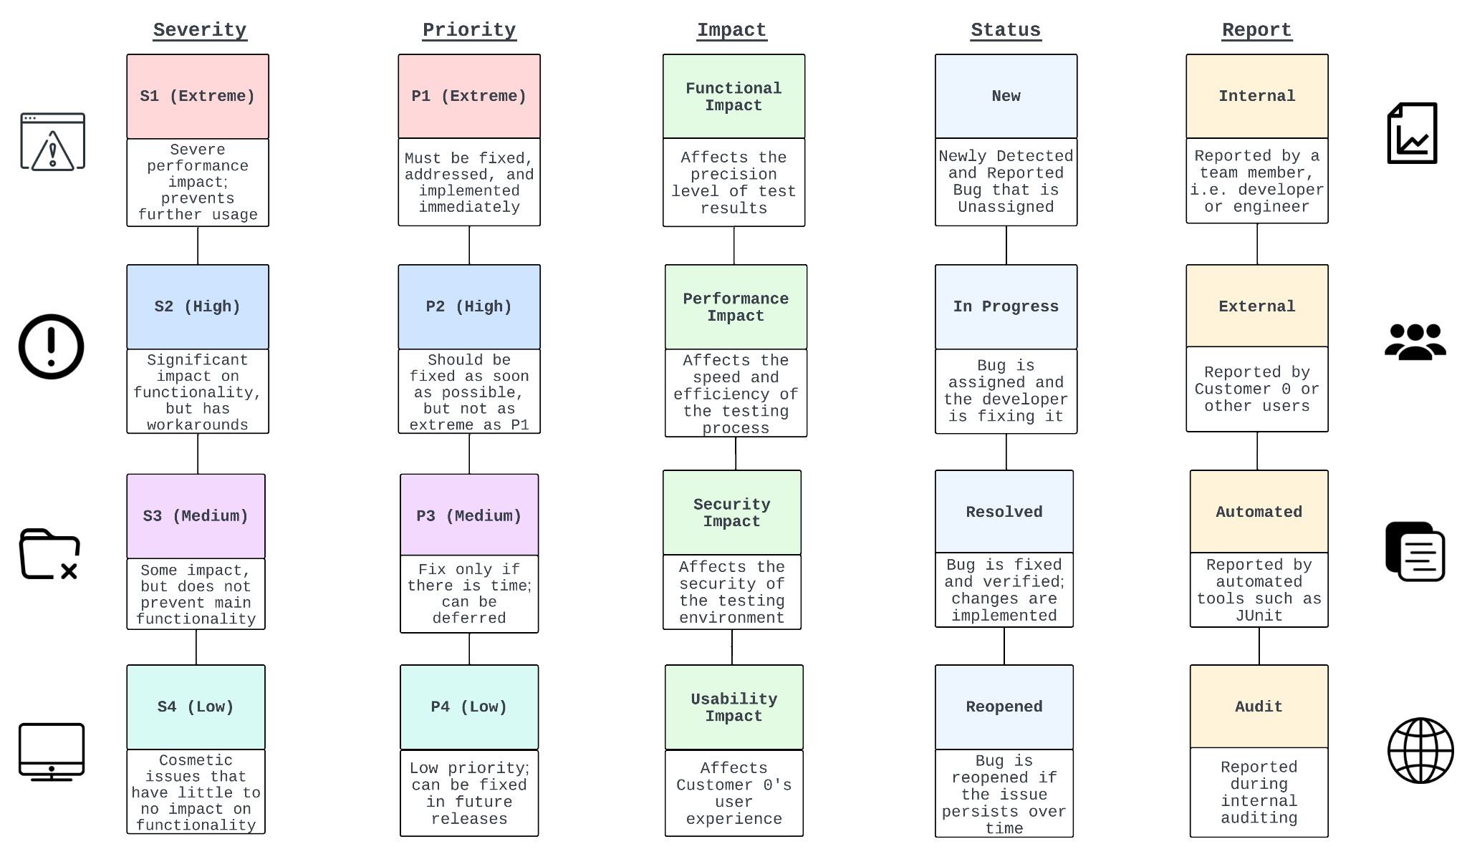
Bug Management Criteria [1, 2]
[1] Understanding Bug Life Cycle in Software Testing. Retrieved May 25, 2024 from https://browserstack.wpengine.com/guide/bug-life-cycle-in-testing/
[2] What is Defect/Bug Life Cycle? A Complete Guide. Retrieved May 25, 2024 from https://katalon.com/resources-center/blog/bug-defect-life-cycle
Simple

Slide 59
Release Management
Title

Slide 60
Release Criteria
Increment | Theme | Criteria | Verification Method (critical V&V steps)
Increment 1 | Precision | 20% reduction in false positives when compared to manual testing. | Compare the number of false positives from automated tests to historical data from manual tests. Calculate the percentage reduction and confirm it meets the 20% target.
 |  | 100% pass rate for the results of automated tests when compared with historical manual test results (test strategy theme: precision) | Generate detailed reports from both automated and historical manual tests. Perform a side-by-side comparison of test results, focusing on critical test cases. Log discrepancies as bugs in Bugzilla for further analysis. Resolve all discrepancies to ensure 100% resolution rate.
 |  | 100% pass rate for integration tests of integrate Selenium with Jenkins CI/CD for the 120 manual tests (test strategy theme: efficiency) | Verify Jenkins pipeline configuration to ensure Selenium scripts for the 120 manual tests are integrated. Run a set of test scripts through the CI/CD pipeline and success rate of execution will be recorded in Detailed test result reports using TestRail. Track and resolve 100% any integration issues in Bugzilla.
 | Efficiency | Achieve a 50% reduction in execution time for Selenium Grid tests across multiple browsers compared to initial setup. | Configure Selenium Grid for parallel testing and execute tests. Monitor and document the initial and optimized execution times and resource usage. Calculate the percentage reduction in execution time and confirm it meets the 50% target.
 |  | Reduce the setup and automated test execution time for 120 automated unit tests and 30 manual unit tests to a total of 72 hours. | Track and record the total setup and execution time for all 150 tests. Ensure the combined time for setup and execution does not exceed 72 hours. Compare the setup and execution times to previous benchmarks and log delays and issues in Bugzilla. Calculate and verify the setup time reduction to meet the 72-hour target.
Simple

Slide 61
Release Checklist
（Focus: Increment 1）
Test Strategy Theme | Criteria | Artifact | Responsible | Accountable | Consulted | Informed
Precision | 20% reduction in false positives when compared to manual testing | Comparison report with history data | Brian Tran (IT DevTester) | Jamie Teller (DevOps Engineer) | Krista Adams (Product Engineer) | Alex Hart (Security Manager)
 | 100% pass rate for the results of automated tests when compared with historical manual test results | Detailed reports from automated and historical tests | Brian Tran (IT DevTester) | Jamie Teller (DevOps Engineer) | Krista Adams (Product Engineer), Security Manager | Jennifer Clark (SOC Analyst)
 |  | Side-by-side comparison document | Brian Tran (IT DevTester) | Jamie Teller (DevOps Engineer) | Krista Adams (Product Engineer), Security Manager | Jennifer Clark (SOC Analyst)
 | 100% pass rate for integration tests of Selenium scripts with Jenkins CI/CD for the 120 manual tests | Detailed test result reports using TestRail | Brian Tran (IT DevTester) | Jamie Teller (DevOps Engineer) | Krista Adams (Product Engineer), Security Manager | Jennifer Clark (SOC Analyst)
Efficiency | Achieve a 50% reduction in execution time for Selenium Grid tests across multiple browsers compared to initial setup | Initial execution time report | Jamie Teller (DevOps Engineer) | Jamie Teller (DevOps Engineer) | Brian Tran (IT DevTester) | Krista Adams (Product Engineer)
 |  | Optimized execution time report | Jamie Teller (DevOps Engineer) | Jamie Teller (DevOps Engineer) | Brian Tran (IT DevTester) | Krista Adams (Product Engineer)
 | Reduce the setup and automated test execution time for 120 automated unit tests and 30 manual unit tests to a total of 72 hours. | Execution time summary | Brian Tran (IT DevTester) | Jamie Teller (DevOps Engineer) | Krista Adams (Product Engineer) | Alex Hart (Security Manager)
Simple

Slide 62
Version Policy
VERSION Key Factors:[1,2]
Traceable with BUILD. BUILD is coupled with product development or test engineering build farm (files, directories; packages, modules, functions/procedures; components, containers; subsystems).
CyberSIEM build farm is structured into THREE directories: PRECISION, EFFICIENCY, SECURITY, .
Build Types: D for development build (unit tests); A for Alpha build; B for Beta build; S for System test build; R for regression test build; I for Integration Build; P for Performance test build; G for Production GOLDEN build.
VERSION Rules[3]:
MAJOR.MINOR.DOTDOT.[P<PRECISION>,E<EFFICIENCY>,S<SECURITY>].[BUILD TYPE].[DEBUG BUILD OR NOT : D for debug, ND for non-debug].number [1-N]
MAJOR starts from zero at the beginning of the project and ends with 1 when it’s ready to be fully integrated.
During the intermediate sub-milestones, MINOR will have different numbers rounding up to 10 for different modules.
Patch number changes when a new feature is added or modified. This is normally for small bug-fixes or the like.
[1] SemVer. 2020. Semantic Versioning 2.0.0. Retrieved June 3, 2024, from https://semver.org/
[2] Microsoft. 2024. Versioning. Retrieved June 3, 2024, from https://learn.microsoft.com/en-us/dotnet/standard/assembly/versioning
[3] Stack Overflow. 2024. What rules does software version numbering follow?. Retrieved June 3, 2024, from https://stackoverflow.com/questions/3826580/what-rules-does-software-version-numbering-follow
Simple

Slide 63
Release Plan
Timeline | Jan | Feb | March | April | May | June
Increment/Release Version | V0.2.0 Increment 1 (Precision theme, development unit tests) | V0.3.0 Increment 1 (Efficiency theme, integration test) | V0.5.0 Increment 2 (precision/efficiency themes; alpha test, regression test) | V0.7.0 Increment 2 (Precision Theme; Beta Test) | V0.8.0 Increment 3 (Efficiency Theme; System/ Performance Test) | V1.0.0 Increment 3 (Security Theme; Golden Build Test)
Release Versions | V0.0.0.P.D.ND.7 V0.1.0.P.D.ND.5 | V.0.2.0.E.I.ND.3 V0.2.0.E.I.ND.6 | V0.3.0.E.A.ND.4 V0.4.0.P.R.ND.3 | V0.5.0.P.S.ND.5 V0.6.0.P.B.ND.3 | V0.7.0.E.S.ND.5 V0.7.0.E.P.ND.8 | V0.8.0.S.G.ND.3 V0.9.0.S.G.ND.5
Release Highlights | 40% Automated unit tests, Reduction in false positive testing, Precision testing against historical tests, Integration of Selenium with Jenkins CI/CD | Selenium Grid feature added, 33% reduced setup time to 48 hours | Over 95% regression test pass rate, 50% reduction in execution time to 48 hours for Selenium Grid tests across multiple browsers compared to initial execution time, 0 high severity bugs in test setup/execution | JUnit reporting feature added, 50% reduction in false positives rate with 97% precision, Beta testing | 75% reduction in test execution time to 24 hours compared to initial execution time, total turnaround time (setup & execution) is 72 hours | 0 control related security incidents, limit security incident response time to 1 hour
Key Contents | Test Script Set, False Positive Patch, Test result reports, Execution time summary | Selenium Grid configuration file, Setup time report | Jenkins Configuration, Regression test reports, Execution time summary | Selenium WebDriver configuration file, Beta test feedback and validation reports | Performance test reports, System test reports, Execution time summary | Security test reports
Simple

Slide 64
Change Management
Title

Slide 65
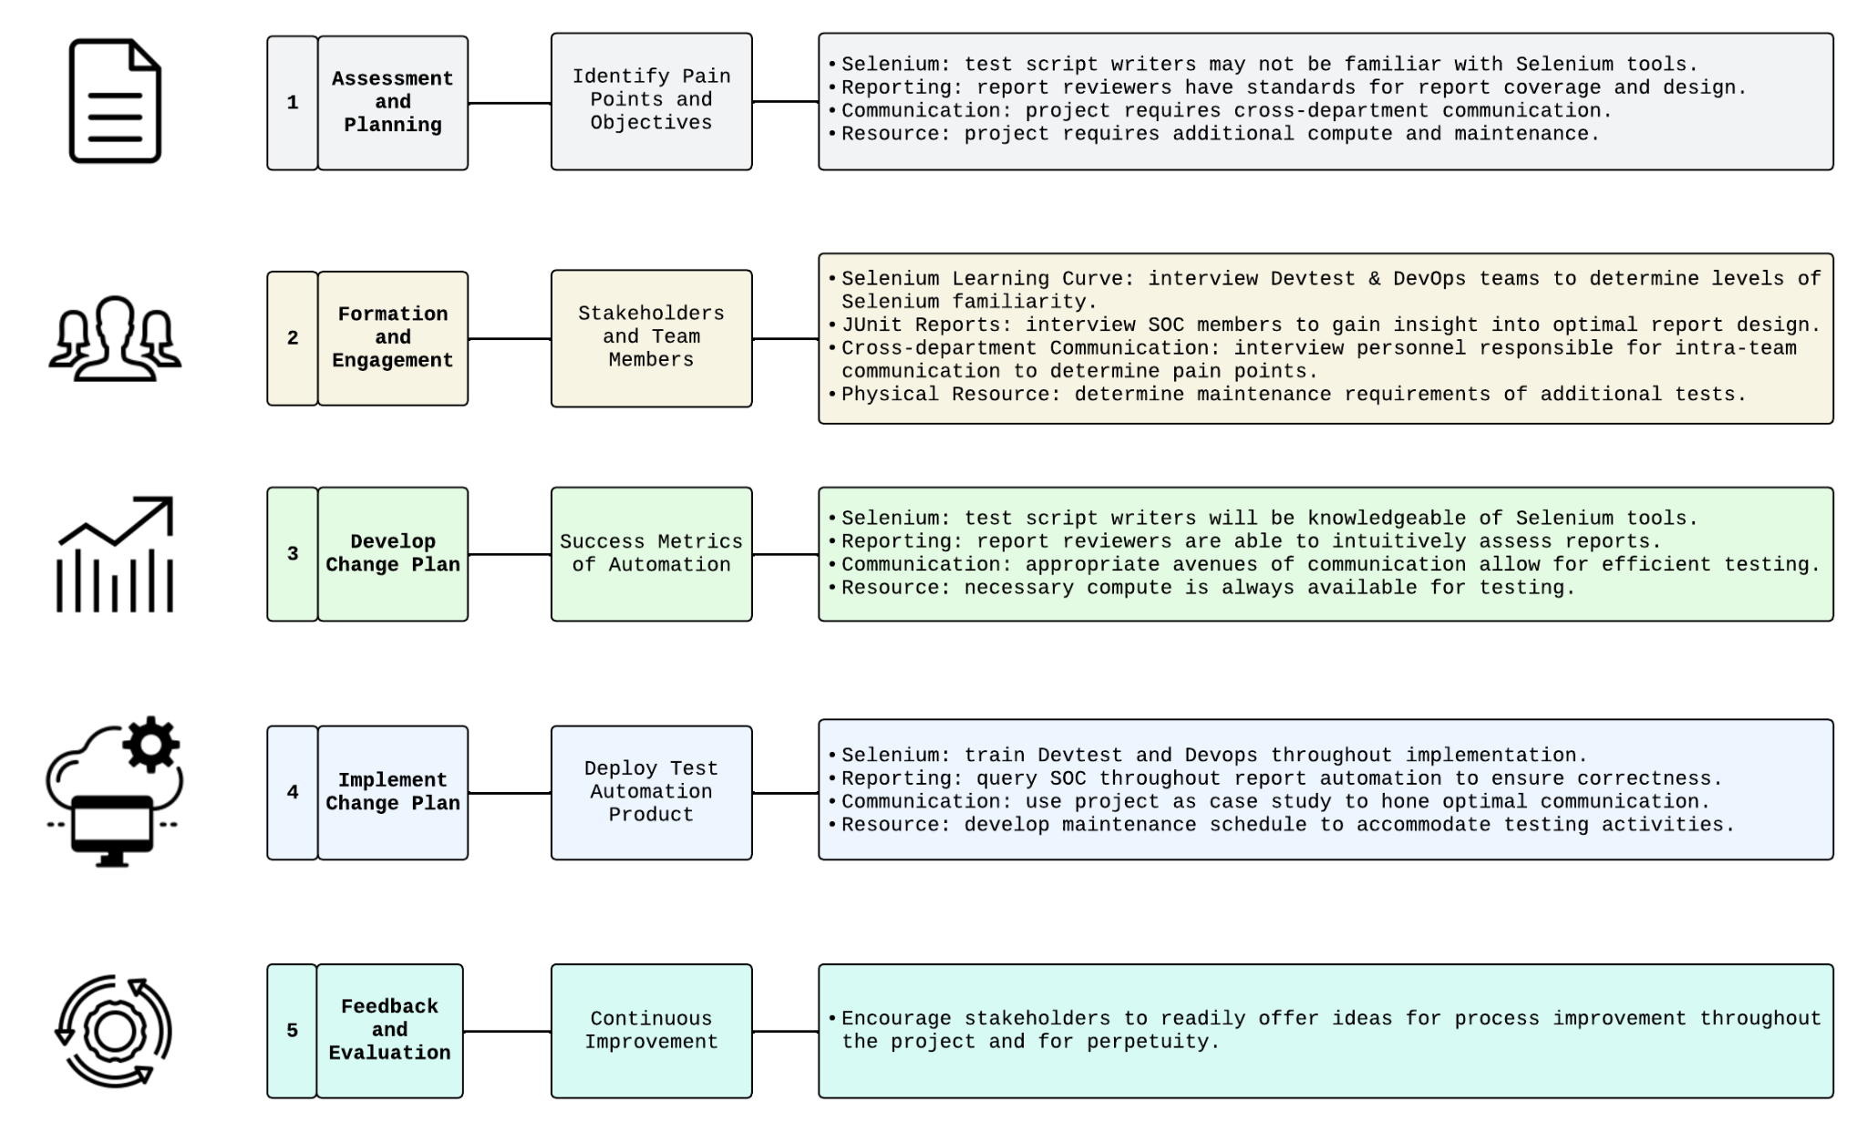
Change Management [1]
[1] 2024. 5 critical steps in the change management process. Retrieved May 17, 2024 from https://www.atlassian.com/blog/strategy/change-management-steps
Simple

Slide 66
Project Plan
Title

Slide 67
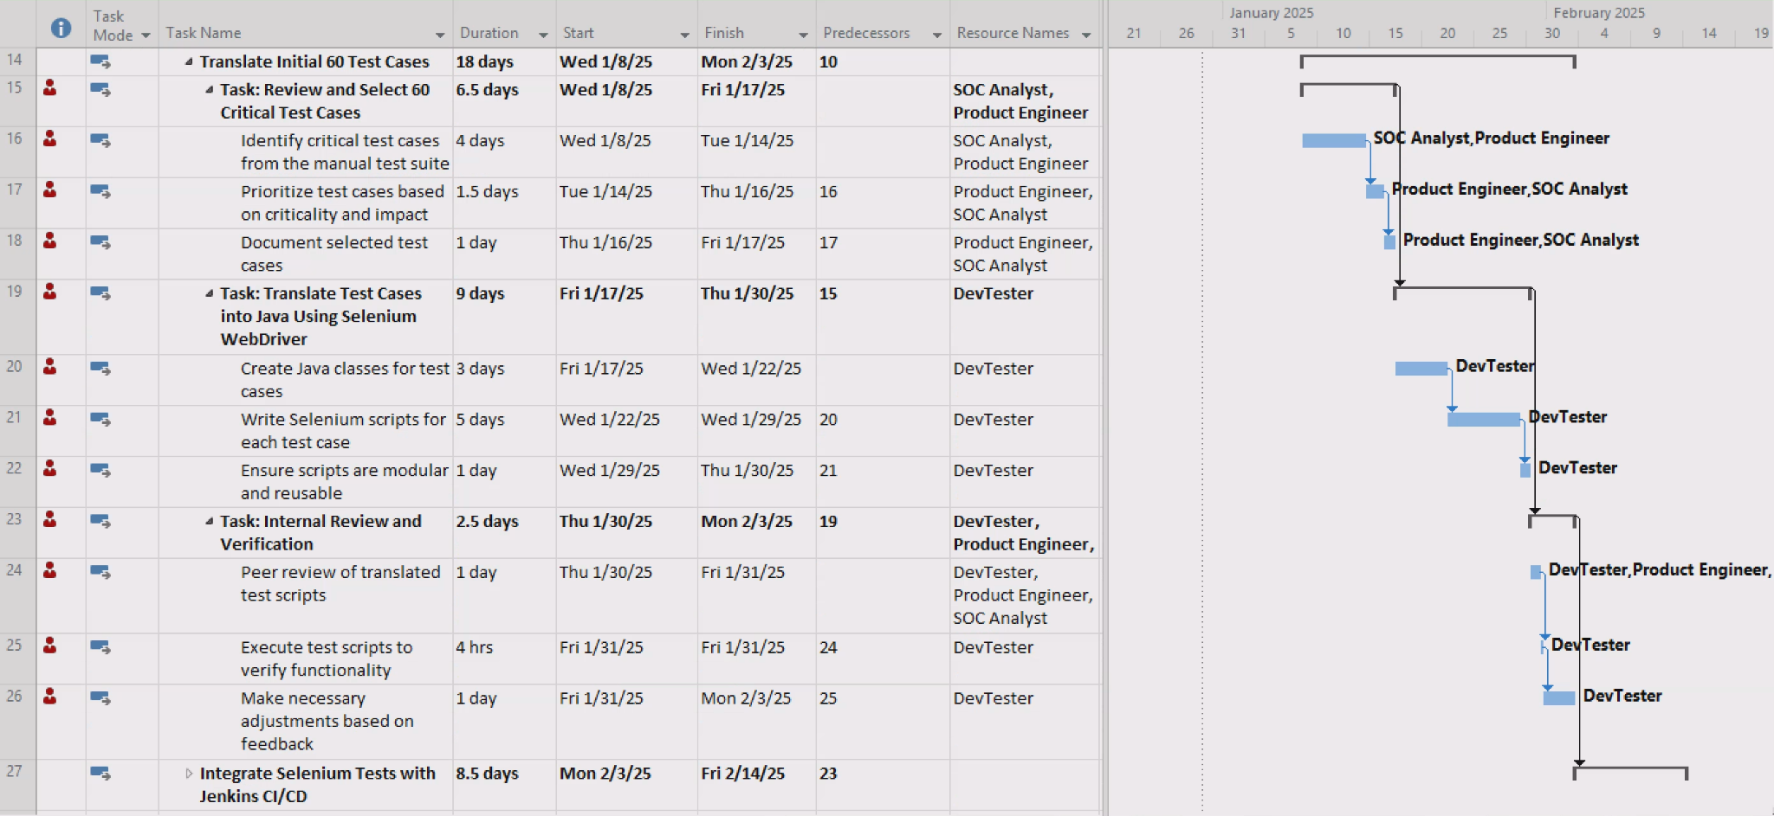
Increment 1, Sprint 1 Project Plan
Section: “Translate Initial 60 Test Cases”
Simple

Slide 68
“Translate Initial 60 Test Cases” RACI ^{[1]}
[1] TeamGantt. RACI Chart Definition, Tips, and Example. Retrieved June 2, 2024, from https://www.teamgantt.com/blog/raci-chart-definition-tips-and-example#:~
=simple%20RACI%20chart-,RACI%20definitions%20explained,have%20on%20an%20individual%20deliverable
Theme | Tasks | Responsible | Accountable | Consulted | Informed
Review and Select 60 Critical Test Cases | Identify critical test cases from the manual test suite | SOC Analyst: selects critical tests from customer perspective | Security Manager: verifies that test cases capture critical controls | DevTest: advises selection from IT maintenance perspective | Product Engineer
 | Prioritize test cases based on criticality and impact | SOC Analyst | DevTest: verifies that tests are automatible | Product Engineer: ensures initial test selection is representative of UI BATs | Security Manager
 | Document selected test cases | SOC Analyst | Security Manager | DevTest | CIO
 |  | Product Engineer
Translate Test Cases into Java Using Selenium Webdriver | Create Java Classes for test cases | DevTest | Product Engineer: ensures code quality | DevOps: opportunities for CI/CD efficiencies | Security Manager
 | Write Selenium scripts for each test case | DevTest | Product Engineer | DevOps | Security Manager
 | Ensure scripts are modular and reusable | DevTest | Product Engineer | DevOps | Security Manager
Internal Review and Verification | Peer review of translated test scripts | Product Engineer | DevTest | SOC Analyst | Security Manager
 | Execute test scripts to verify functionality | DevTest | SOC Analyst: expected test points covered | Product Engineer: opportunities to reuse BAT sample data | Security Manager
 | Make necessary adjustments based on feedback | DevTest | SOC Analyst | Product Engineer | Security Manager
Simple

Slide 69
Thank You
Title

Slide 70
Appendix
Backup

Slide 71
Team Nirvana Sprint Execution
Standups
Progress Stages
Done
Sun - 1 hr Zoom: set week goals/gain consensus
M/W - 20 minute: before class prog update
T/Th - 1 hr Zoom: incorporate new insights from class
Fri: ½ - 1 hour Zoom: Reassess after Prof. insights, plan for weekend
PROG1: Research conducted and organized
PROG2: Translation of research to user story solution
PROG3: Pending team consensus
Team Nirvana agrees that “done” is when a user story solution has pertinent references, overwhelming majority consensus (over ⅔ team approval), and is added to the deck in an aesthetically continuous manner.
Backup

Slide 72
Story Points
 | GRADING | POINTS | RATIONALE
Planning Poker (Fibonacci) | Very Simple | 1 | The deliverable is extremely straightforward The team has all necessary resources at hand and can be easily comprehended It is expected to be completed quickly without any dependencies
 | Simple | 2 | The deliverable is clear with minimal intricacies, perhaps requiring one short discussion for alignment. It requires a single team member without needing input or assistance and can be completed independently
 | Moderately Simple | 3 | The deliverable is still simple and well understood but might require breaking it down into a couple of subdivisions. The team understands the primary goal but might need to clarify certain aspects or prerequisites. Deliverable would involve dependencies.
 | Moderate | 5 | A deliverable of moderate complexity, which might require a series of discussions to fully understand. The team can decompose it into 2-3 divisions that may require sequential flow and requires dependencies to drive it to completion
 | Fairly Complex | 8 | A highly complex deliverable that involves various aspects of the project and requires significant effort or problem-solving It will need to be divided into more than 3 smaller divisions and will require effort to define and clarity. The deliverable may have unknowns which might induce risk and has multiple dependencies
Backup

Slide 73
Draft Report Sprint Backlog Plan
Sprint 1 (23 points)
Sprint 2 (37 points)
Sprint 3 (54 points)
April 12: (Proposal) Context Setting & Articulation (12 pts)
Context/Setting (3 pts)
OSS Project (5 pts)
Hypothesis (2 pts)
Challenges (2 pts)
April 12: OSS Research (6 pts)
Upstream (3 pts)
Downstream (3 pts)
April 12: OSS Principles (5 pts)
Whos, Who (5 pts)
April 19: Market Research (11 pts)
SWOT (3 pts)
COMP Analysis (5 pts)
GOAL/Problem (3 pts)
April 19: ROI/ROV (13 pts)
ROI (8 pts)
ROV (5 pts)
April 19: SDLC Model (8 pts)
April 19: SW Disaster (5 pts)
Relevance (2 pts)
Risks (3 pts)
April 25: 5 Personas (2 pts x 5 = 10 pts)
Characterization (1 pts)
Rationalization (1 pts)
April 25: 5 User Stories (5pts x 5 = 25 pts)
Epic Stories (2 pts)
Decomposition (3 pts)
April 25: Relative Sizing Algo (5 pts)
April 25: Roadmap (8 pts)
April 25: Burnup Chart (3 pts)
April 25: Sprint 1 Planning (3 pts)
Backup

Slide 74
Draft Report Sprint Backlog Execution
Sprint 1 (18 points)
Sprint 2 (39 points)
Sprint 3 (62 points)
April 12: (Proposal) Context Setting & Articulation (12 pts)
Context/Setting (3 pts)
OSS Project (5 pts)
Hypothesis (2 pts)
Challenges (2 pts)
April 9: OSS Research (6 pts)
Upstream (3 pts)
Downstream (3 pts)
April 19: OSS Principles (5 pts)
Whos, Who (5 pts)
April 19: Market Research (11 pts)
SWOT (3 pts)
COMP Analysis (5 pts)
GOAL/Problem (3 pts)
April 19: ROI/ROV (13 pts)
ROI (8 pts)
ROV (5 pts)
April 19: SW Disaster (5 pts)
Relevance (2 pts)
Risks (3 pts)
April 19: [Replan] Context Setting & Articulation (+ 5pts)
April 25: SDLC Model (8 pts)
April 25: 5 Personas (2 pts x 5 = 10 pts)
Characterization (1 pts)
Rationalization (1 pts)
April 25: 5 User Stories (5pts x 5 = 25 pts)
Epic Stories (2 pts)
Decomposition (3 pts)
April 25: Relative Sizing Algo (5 pts)
April 25: Roadmap (8 pts)
April 26: Burnup Chart (3 pts)
April 27: Sprint 1 Planning (3 pts)
Backup

Slide 75
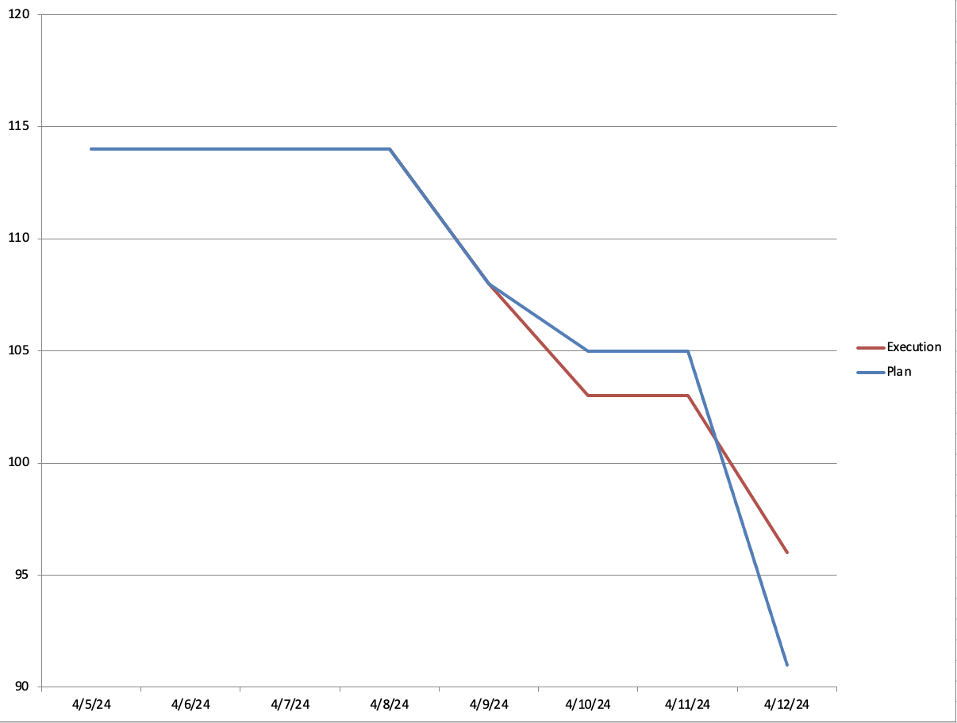
Sprint 1 Burndown Chart
Backup

Slide 76
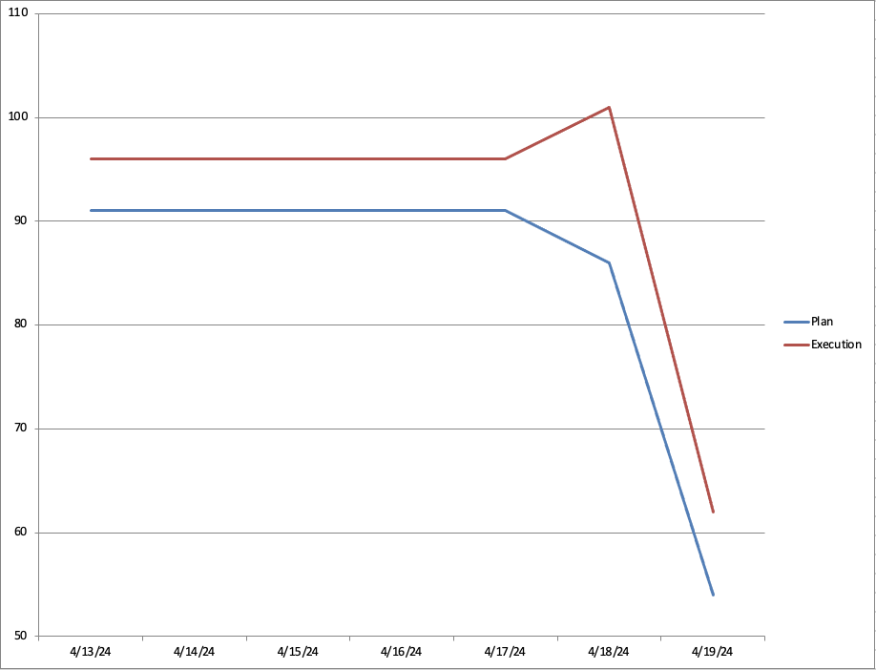
Sprint 2 Burndown Chart
Replan
Backup

Slide 77
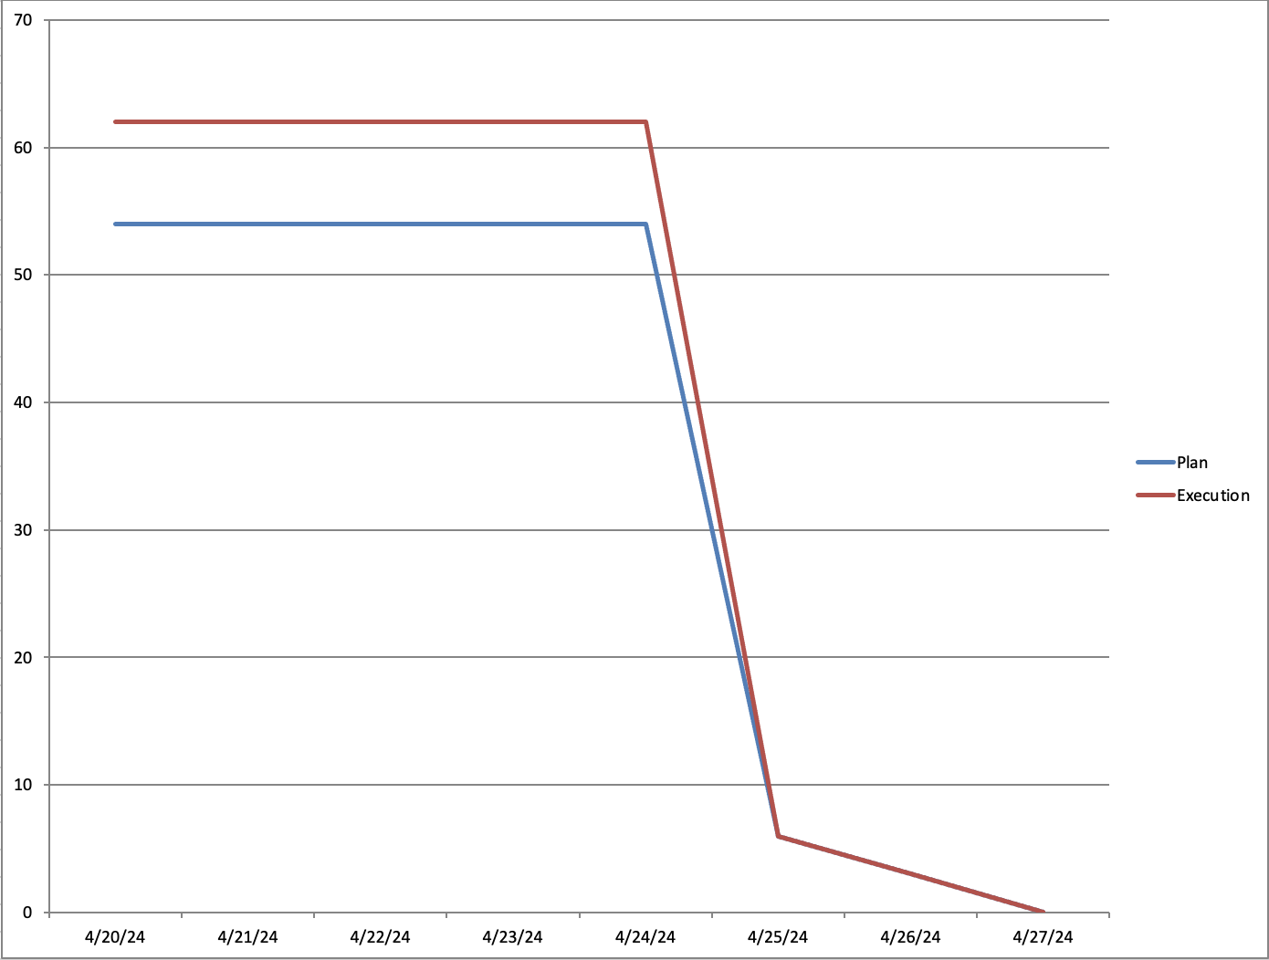
Sprint 3 Burndown Chart
Backup

Slide 78
Final Report Sprint Backlog Execution
Sprint 4 (14 points)
Sprint 5 (47 points)
Sprint 6 (34 points)
May 20: Architecture, design (8 pts)
Architecture: Call and Return (8 pts)
May 20: As-Is, To-be (10 pts)
As-is (5 pts)
To-be (5 pts)
May 20: User Story Update (6 pts)
DevOps (2 pts)
Dev/Test (2 pts)
Prod Engineer (2 pts)
May 20: SMART Update (3 pts)
May 21: Change Management (3 pts)
May 21: Risk Management (3 pts)
May 23: Testing (8 pts)
Testing Methodology/Rationale (5 pts)
Test Matrix (3 pts)
May 23: Product Roadmap Update (3 pts)
May 23: Burnup Chart Update (3 pts)
May 14: As-Is, To-Be (2 pts)
Adding personas & relevant details as needed (2 pts)
May 14: ROI/ROV (3 pts)
Productivity as ROI (3 pts)
May 14: User Story update (4 pts)
SOC Analyst (2 pts)
SOC Manager (2 pts)
May 14: Story Point Algo Update (3 pts)
May 14: Challenges Update (2 pts)
May 28: Architecture, design (5 pts)
High level design (5 pts)
May 28: Release (11 pts)
Bug Lifecycle (3 pts)
Bug Management Criteria (2 pts)
Release Criteria (3 pts)
Release Checklist (3 pts)
May 28: Release Plan (8 pts)
May 28: Project Plan (5 pts)
May 28: OSS execution (5 pts)
Backup

Slide 79
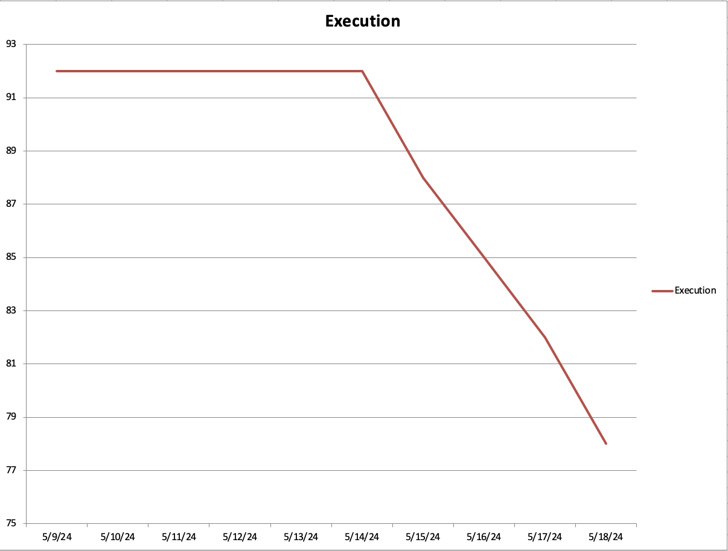
Sprint 4 Burndown Chart
Backup

Slide 80
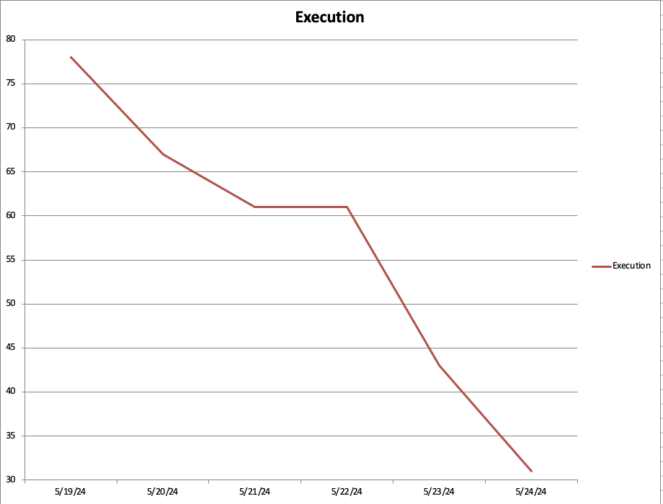
Sprint 5 Burndown Chart
Backup

Slide 81
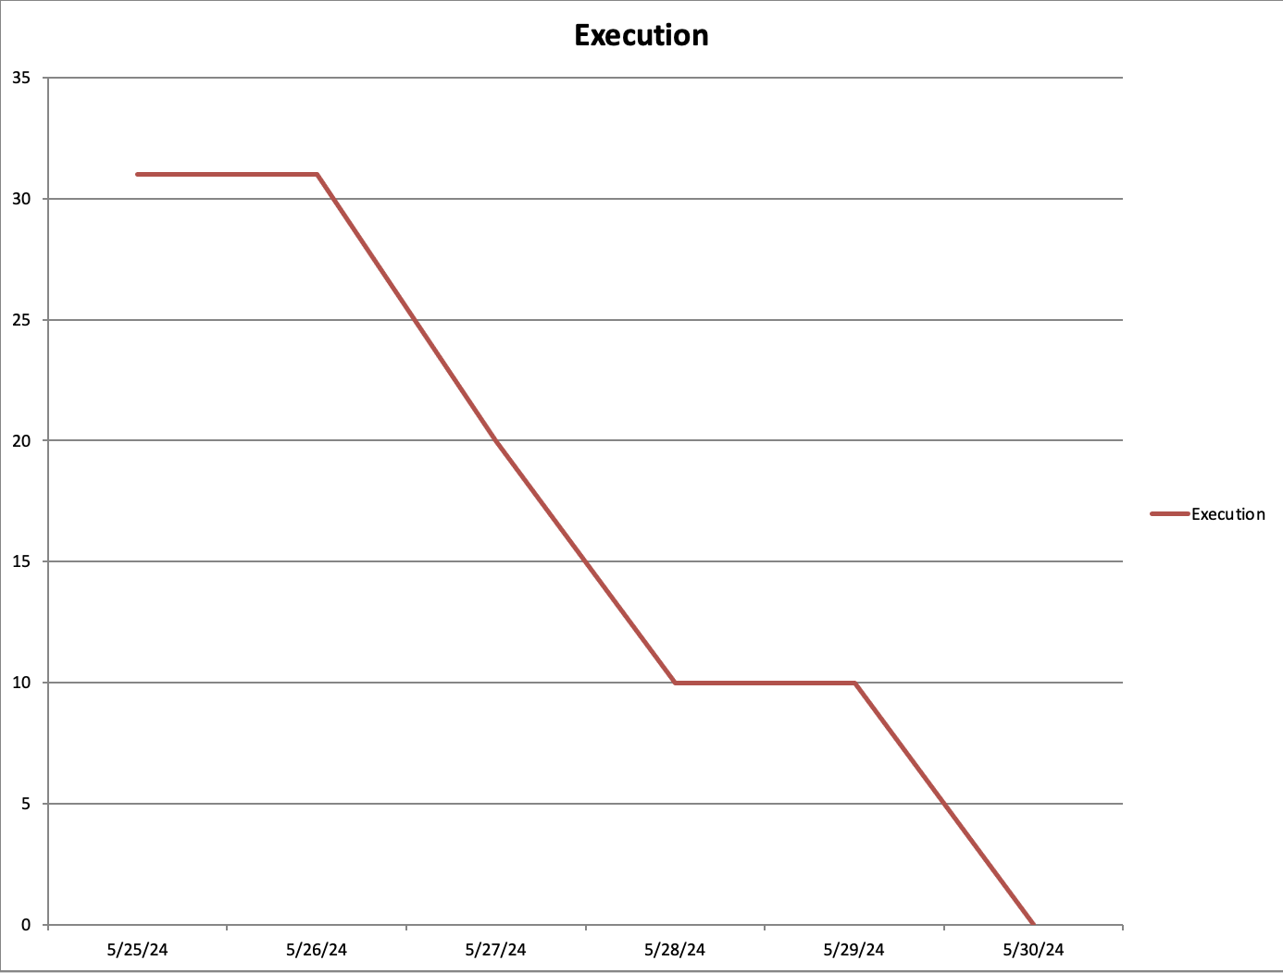
Sprint 6 Burndown Chart
Backup

Slide 82
Abbreviations
AD - Active Directory
CCPA - California Consumer Privacy Act of 2018
CI/CD - Continuous Integration/Continuous Development
GDPR - General Data Protection Regulation
OSS - Open Source Software
PAM - Privileged Access Management
PKI - Public Key Infrastructure
RBAC - Role based Access Control
ROI - Return on Investment
ROV - Return on Value
SIEM - Security Information and Event Management
SOC - Security Operations Center
SDLC - Software Development Life Cycle
Backup

Slide 83
Slide Reading Time
Total Slides : 60 mins ( 21 Title + 39 Simple + 9 Average + 36 Backup = 105 Total Slides
Calculation Rationale:
Title | 10 secs | 21
Simple | 60 secs | 39
Average | 120 secs | 9
Backup | 0 sec | 36
Backup

Slide 84
Artifacts
Notes: User Story ownership was subject to change throughout the entire sprint. Ownership detailed in the following artifacts is not representative of the cumulative efforts requisite for story completion
Backup

Slide 85
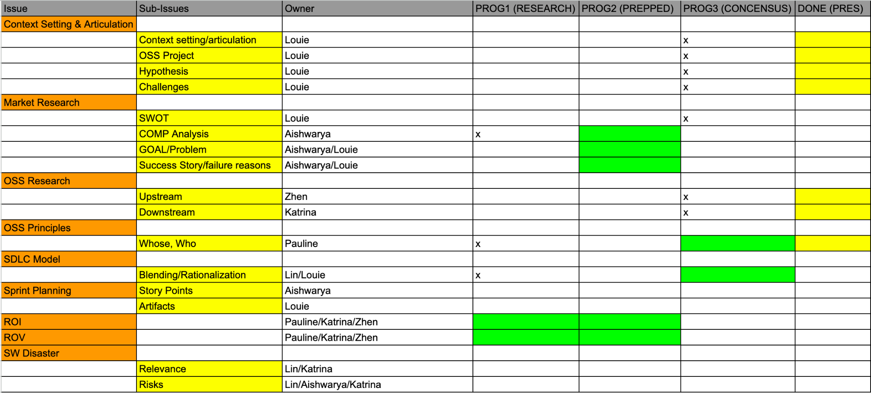
April 18-April 19
Backup

Slide 86
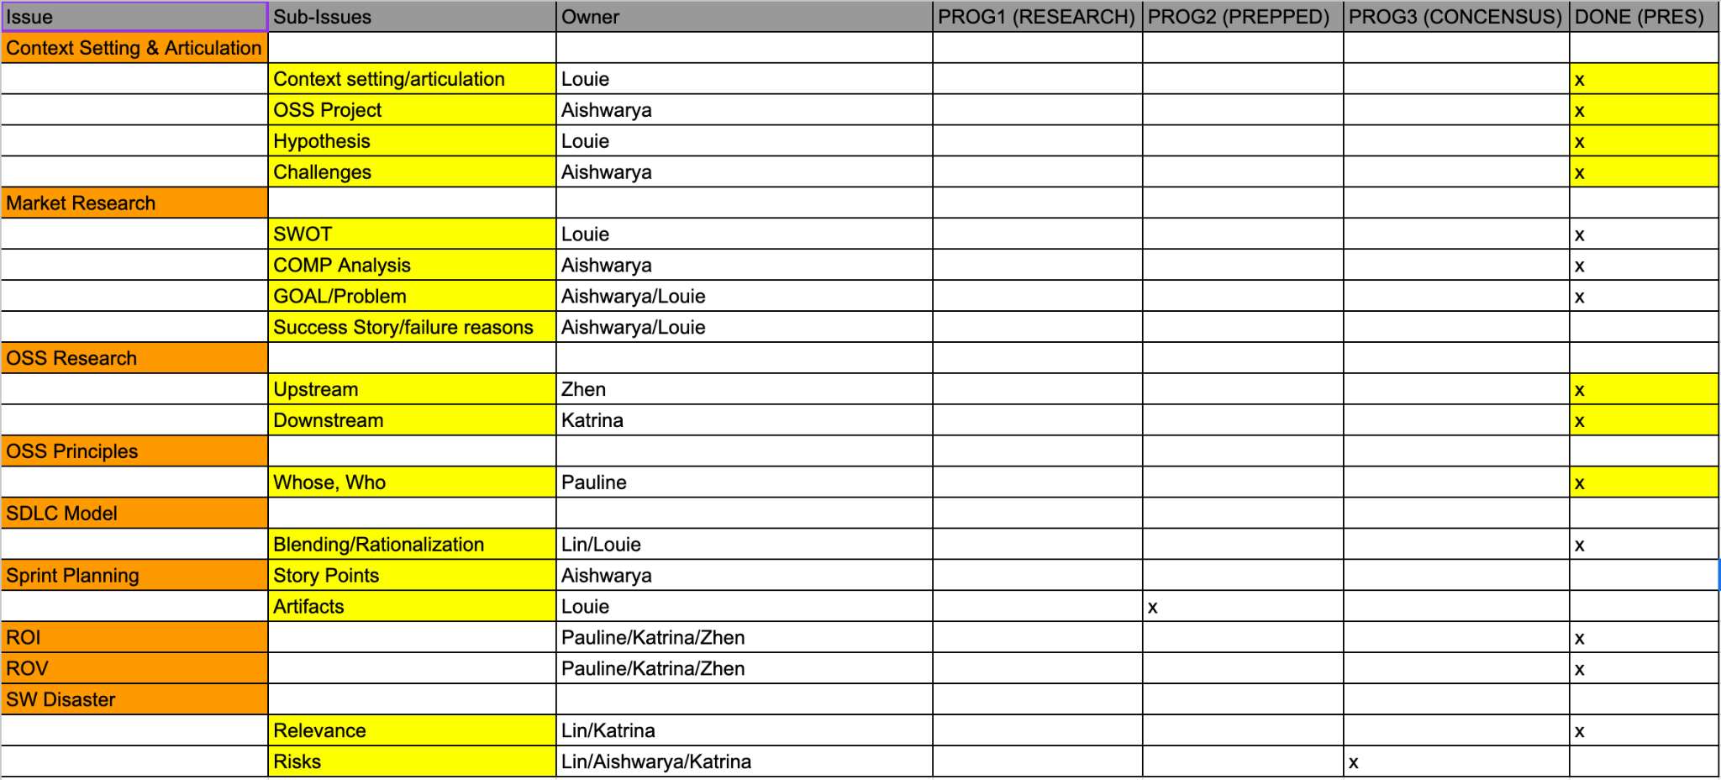
April 19-April 23
Backup

Slide 87
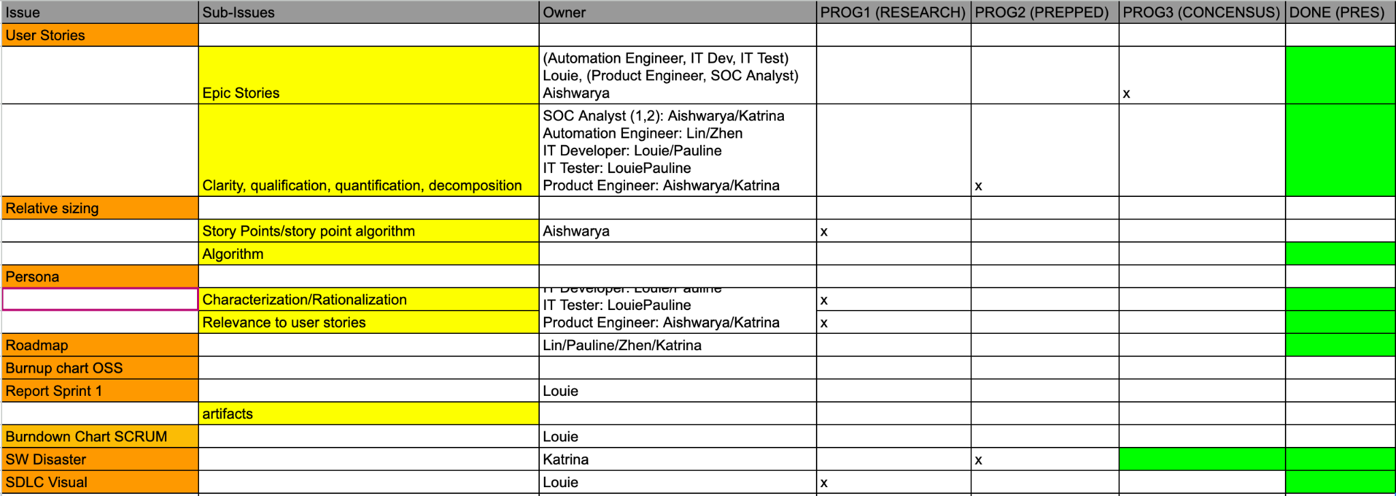
April 23-April 25
Backup

Slide 88

April 25-April 26
Backup

Slide 89

April 26-April 27
Backup

Slide 90
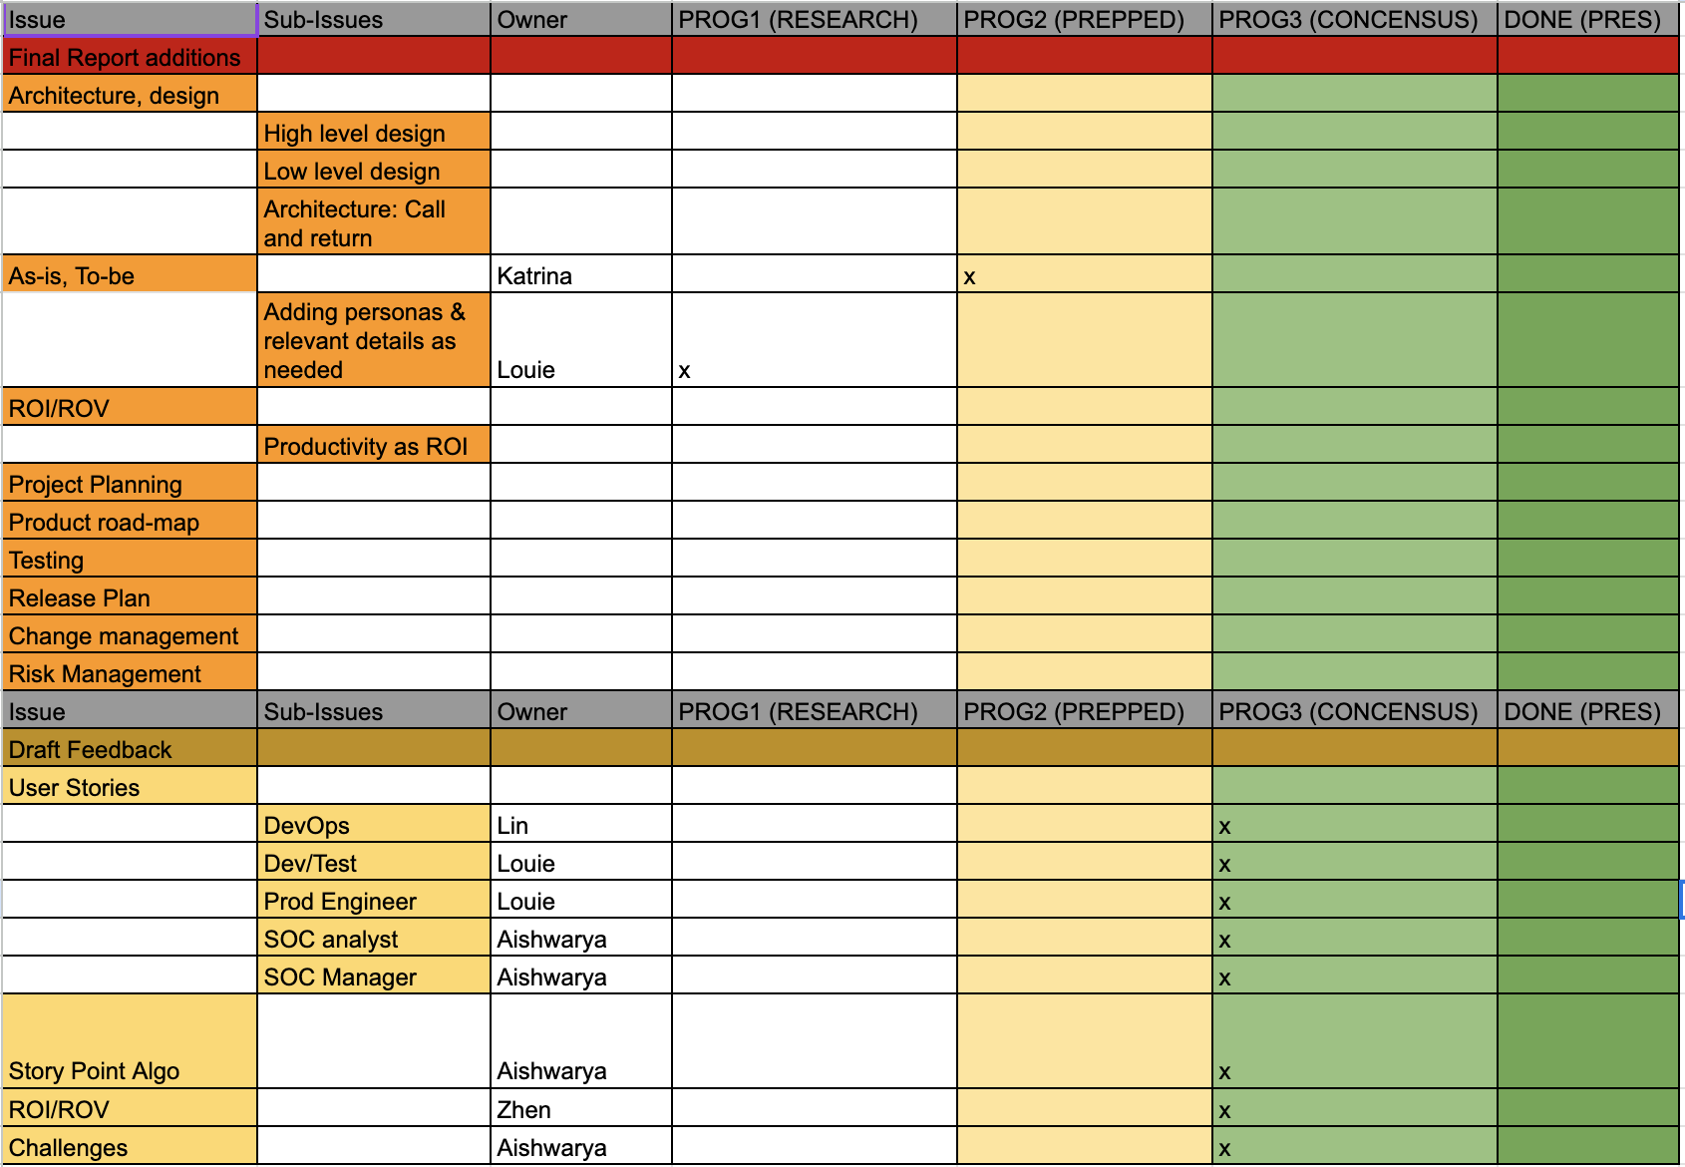
May 10-May 13
Backup

Slide 91
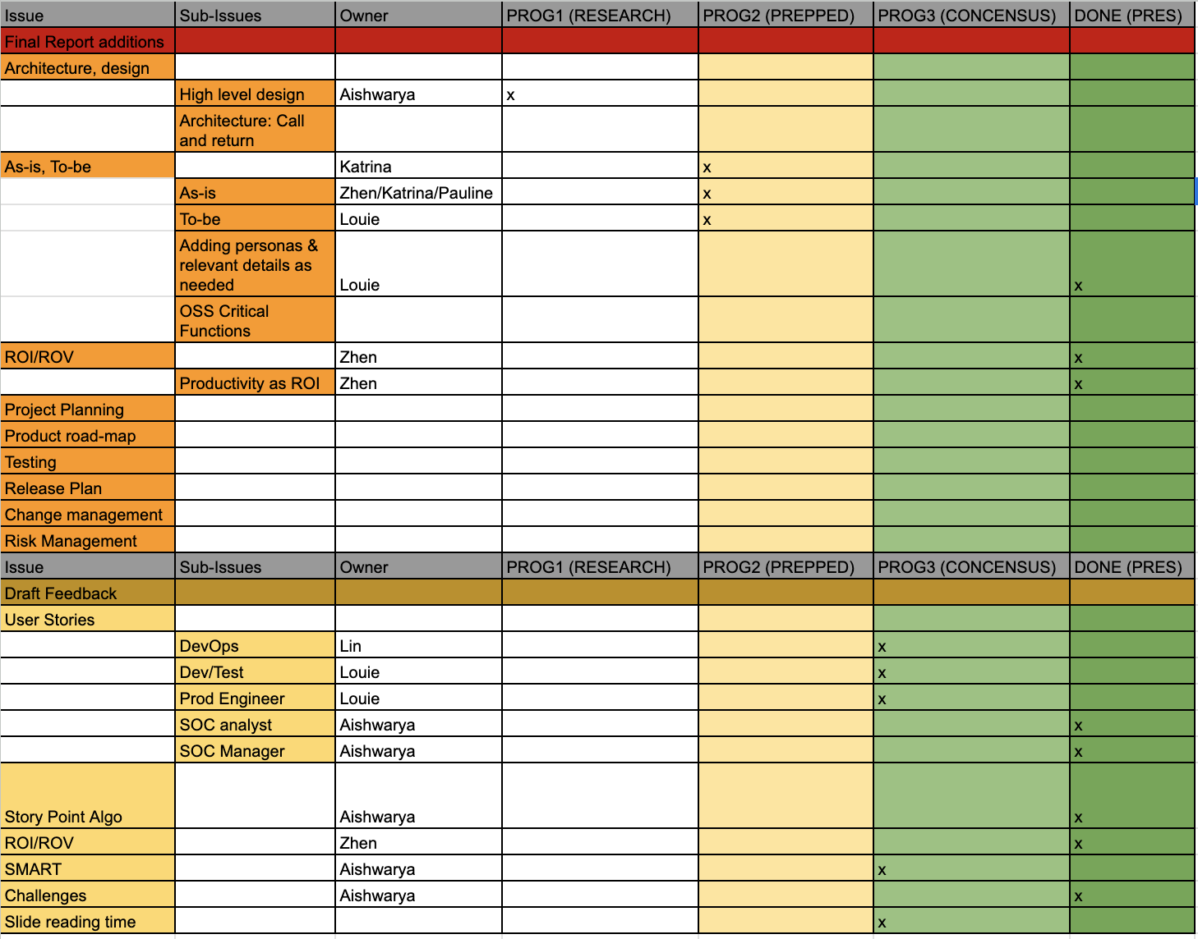
May 14-May 19
Backup

Slide 92
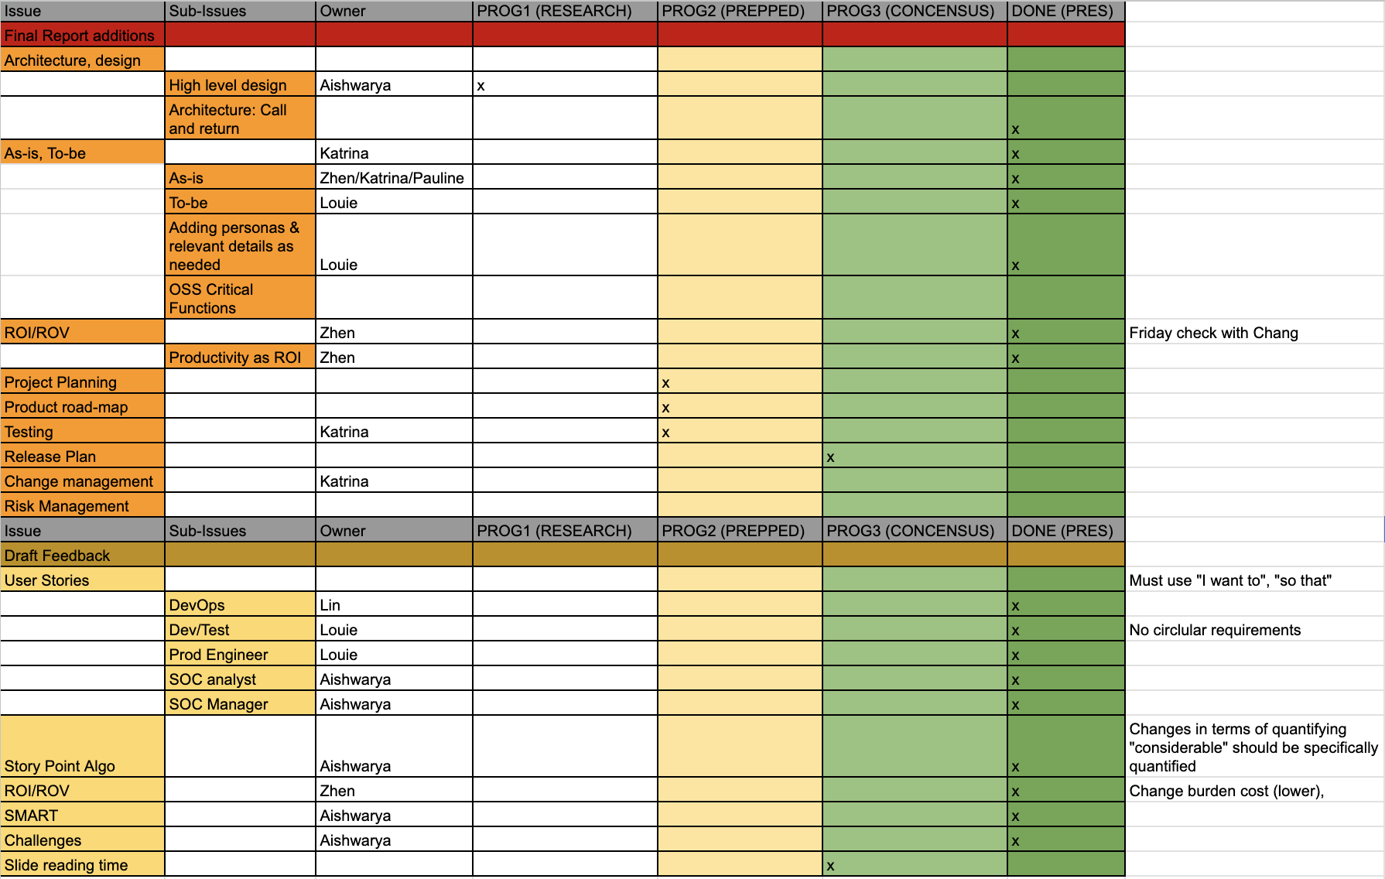
May 20 - May 21
Backup

Slide 93
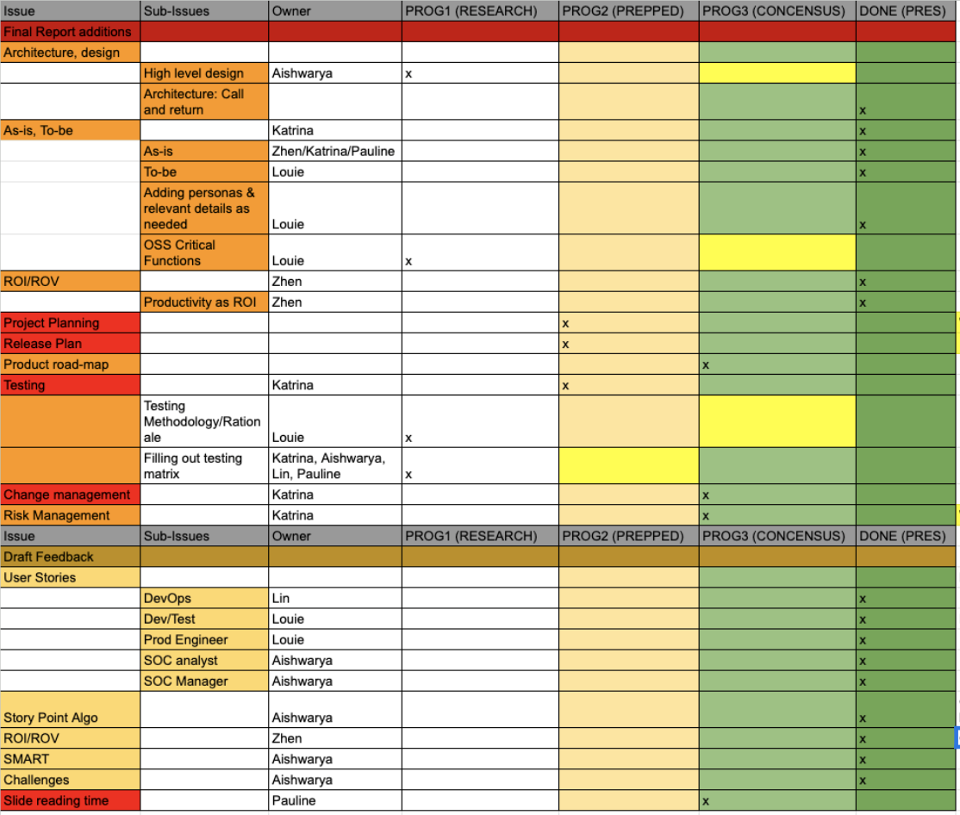
May 21 - May 22
Backup

Slide 94
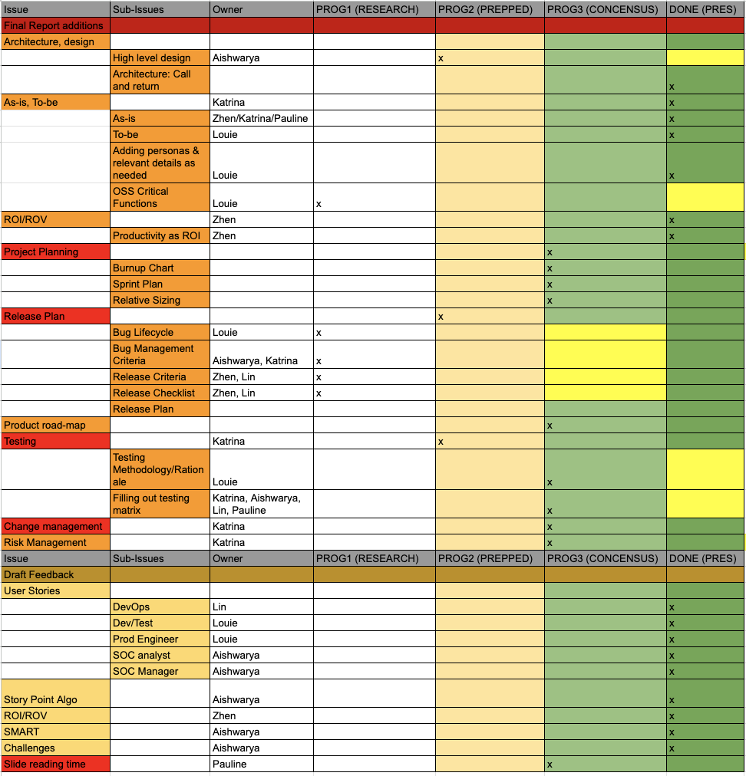
May 23 - May 27
Backup

Slide 95
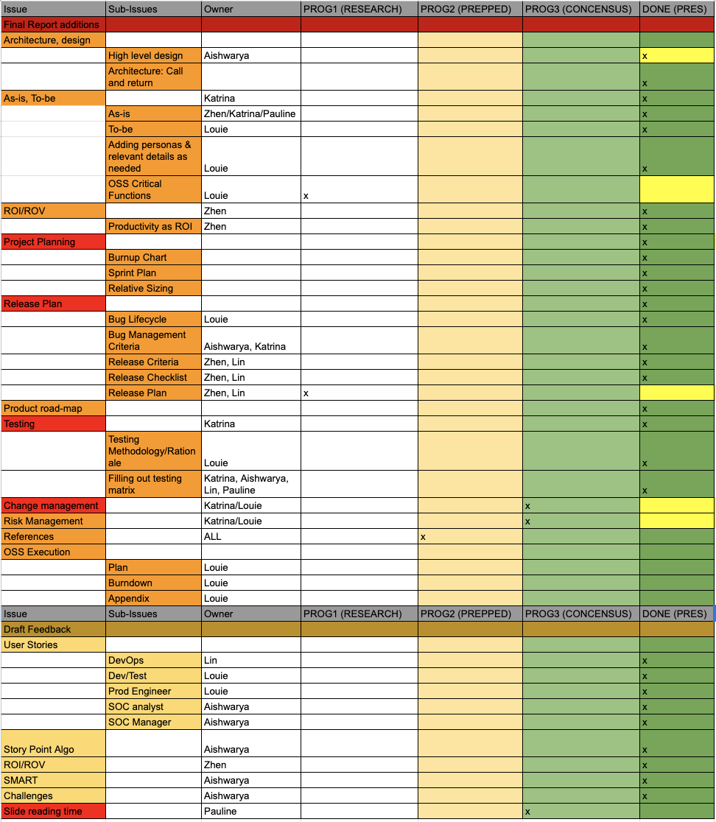
May 28 - May 30
Backup

Slide 96
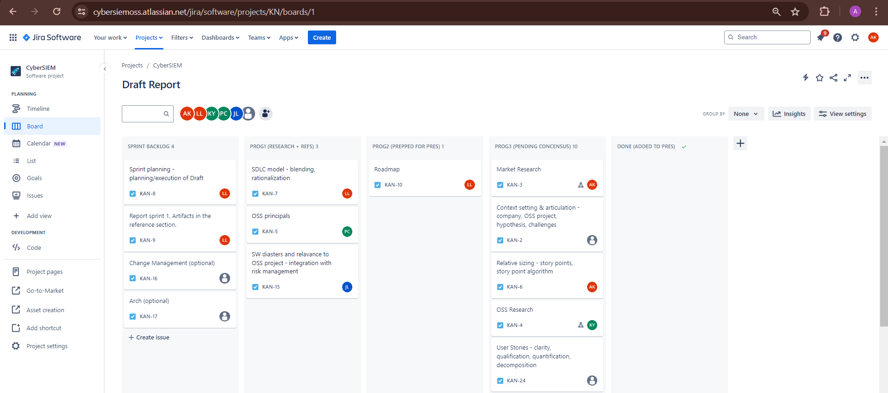
Kanban Board
Backup

Slide 97
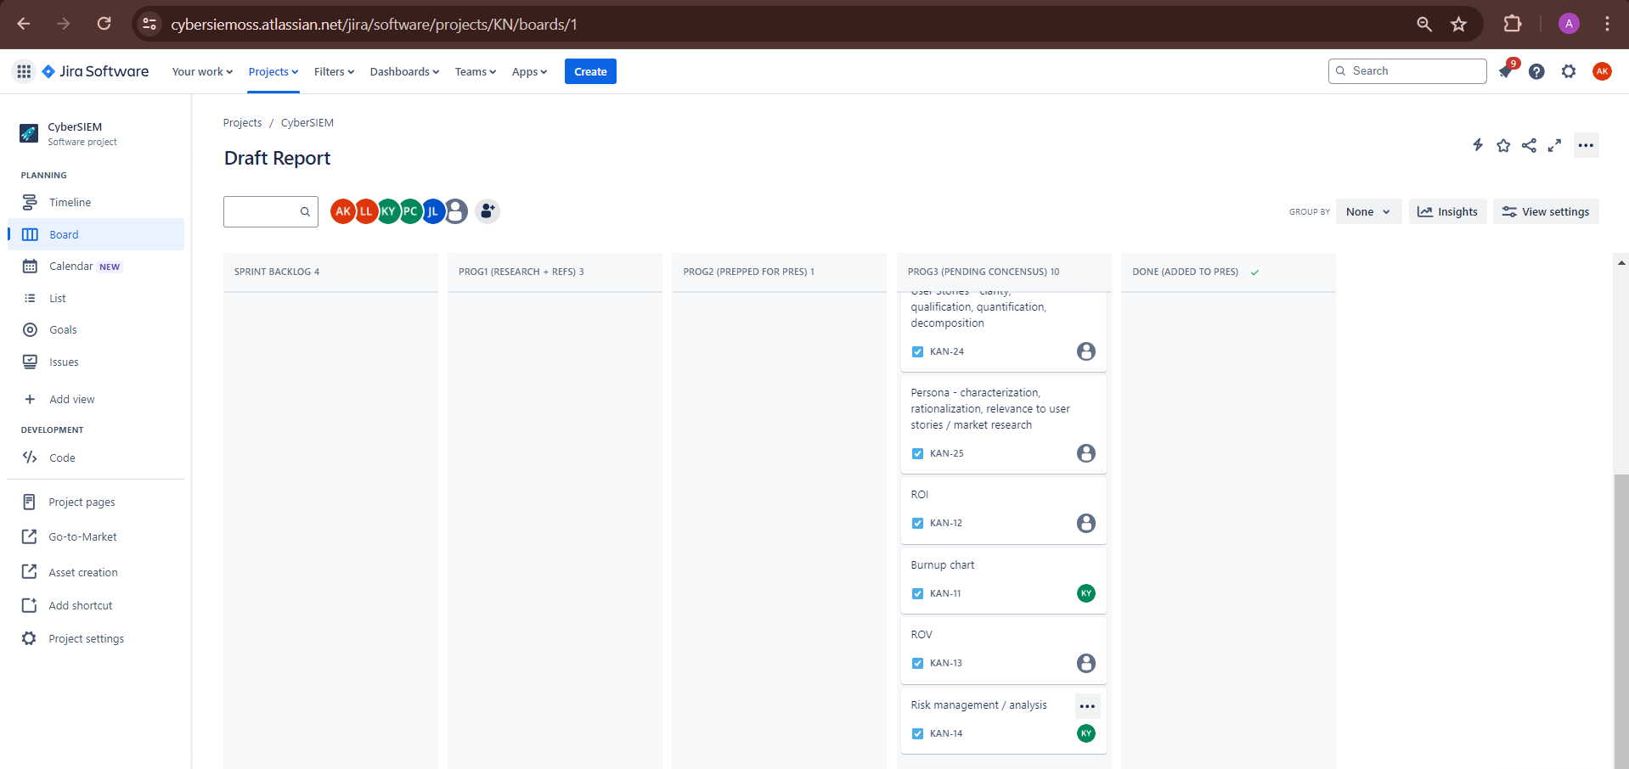
Kanban Board
Backup

Slide 98
Backup Slides

Slide 99
Personas [1]
DevOps
IT DevTester
Product Engineer
SOC* Analyst
Security Manager
[1] Slidesgo. "People Pattern." Accessed April 19, 2024. https://slidesgo.com/theme/people-pattern.
*Security Operations Center
Simple

Slide 100
Sprint Planning
User Story
Relative Sizing
Task Assignment
User stories are created based on different stakeholders’ perspective.
User stories are sized into story point value judging by their priority.
Tasks are assigned to each role according to relevant user stories.
Daily Scrum
Burndown
Review & Retrospective
Engage in daily scrum meetings to resolve any roadblocks.
Keep track of the progress for each task documented in sprint backlog.
Review performance and execution of the sprint plan as a scrum team.
Simple

Slide 101
ROI (Dollar)
Employment Costs and Savings:
Reduction from 15 testers to 6 testers and addition of 2 automation engineers.
Pre-automation 6-month cost for 15 testers: $750K.
Post-automation 6-month cost for 6 testers and 2 automation engineers: $550K.
Total employment cost savings for 6 months: $900K (pre-automation) - $660K (post-automation) = $240K.
Automation Development Cost:
One-time cost for creating and integrating automated scripts: $120K.
Training and IT indirect support services in 6 months: $60K
Costs associated with restructuring of new employees: $20K
Assumptions:
Salary of a Tester according to industry standards: $100K annually.
Salary of an Automation Engineer according to industry standards: $150K annually.
Improved test coverage and accuracy result in a reduction in post-production bugs and related costs.
Enhanced product quality leads to increased customer satisfaction and an estimated increase in sales.
Project duration: 6 months.
Burden rate: 20%.
Backup

Slide 102
ROI (Dollar)
 | Manual | Hardware | AWS^{[1]}
CPU / RAM | 4 Cores CPU 4-8GB RAM | 8 Cores CPU 16GB+ RAM | EC2 Instance (c5.2xlarge)
Storage | 256-512GB SSD | 512GB-1TB SSD | EBS Storage (750GB each)
Data Transfer | / | / | 100GB
Bandwidth | 300-500Gbps | 1Gbps | 10Gbps
ROI Calculation:
Total gain from investment: $240K (employment cost savings) + $100K (additional financial benefits) = $340K.
Total cost of investment: $120K (automation development cost) + ¥60K(shadow resource cost)= $180K.
Net gain from investment: $340K (total gain) - $1800K (total cost) = $160K.
ROI = ($160K / $180K) * 100 = 88.89%.
[1] Amazon Web Services, Inc. "Amazon EC2 Pricing." Accessed April 19, 2024. https://aws.amazon.com/ec2/pricing/.
Backup

Slide 103
ROI (Efficiency)
ROI (Efficiency) = ((Manual Time - Automation Time / Manual Time) x 100)
Note: Time is calculated in Hours; Divided by 8 occurs when manual effort is needed; Divided by 18 occurs when automation is needed; Period of ROI is the overall time frame in weeks ^{[1]}
(a) Automation test script development time
((Hourly automation time per test * Number of automation test cases) / 8) = ((5 * 300) / 8) = 187.5
(b) Automation test script execution time
((Automation test execution time per test * Number of automation test cases * Period of ROI) / 18)
= ((0.5 * 300 * 8) / 8) = 150
(c ) Automation test analysis time
((Test Analysis time * Period of ROI) / 8) = ((1.5 * 8)/8) = 1.5
(d) Automation test maintenance time
((Maintenance time * Period of ROI) / 8) = ((2 * 8) / 8) = 2
(e) Manual Execution Time
(Manual test execution time * Number of manual test cases * Period of ROI)/8) = ((3 * 250 * 8)/8) = 750
Total Automation Time
Automation test script development time + Automation test script execution time + Automation test analysis time + Automation test maintenance time = 187.5 + 150 + 1.5 + 2 = 341
ROI (Efficiency) = ((750-341/750) x 100) = 54.53%
[1] BrowserStack. How to calculate Test Automation ROI. (2021). Accessed: 21 April 2024. Retrieved from: https://www.browserstack.com/guide/calculate-test-automation-roi
Backup

Slide 104
ROI (Efficiency)
[1] BrowserStack. How to calculate Test Automation ROI. (2021). Accessed: 21 April 2024. Retrieved from: https://www.browserstack.com/guide/calculate-test-automation-roi
Note: Period of ROI is 26 weeks (6 months). Automation work hours is 20 hours (can run continuously but expect delays). Manual work hours is an 8 hour workday. Besides Period of ROI, all other time points are in hours.
Formulas^{[1]} | Calculations
Automation Test Script Development Time = ((Hourly automation time per test * Number of automation test cases) / automation work hours) | Automation Test Script Development Time = ((24/300) * 300) / 20 = 1.2
Automation Test Script Execution Time = ((Automation test execution time per test * Number of automation test cases * Period of ROI in weeks) / automation work hours) | Automation Test Script Execution Time = (0.167 * 300 * 26) / 20 = 65.13
Automation Test Analysis Time = ((Test Analysis time per test * Period of ROI in weeks) / automation work hours) | Automation Test Analysis Time = (0.5 * 26) / 20 = 0.65
Automation Test Maintenance Time = ((Maintenance time per test * Period of ROI in weeks) / automation work hours) | Automation Test Maintenance Time = (2 * 26) / 20 = 2.6
Manual Execution Time = ((Manual test execution time per test * Number of manual test cases * Period of ROI in weeks) / manual work hours)) | Manual Execution Time = (1.5 * 300 * 26 ) / 8 = 1462.5
Total Automation Time = Automation test script development time + Automation test script execution time + Automation test analysis time + Automation test maintenance time | Total Automation Time = 1.2 + 65.13 + 0.65 + 2.6 = 69.58
ROI (Efficiency) = ((Manual Execution Time - Automation Time) / Manual Execution Time) x 100) | ROI (Efficiency) = ((1462.5 - 69.58) / 1462.5) x 100 = 95.24%
Backup

Slide 105
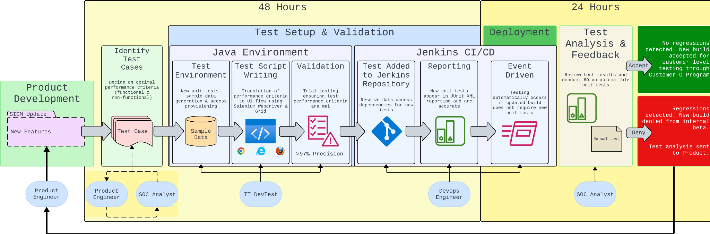
Old Architecture

